Slide 1
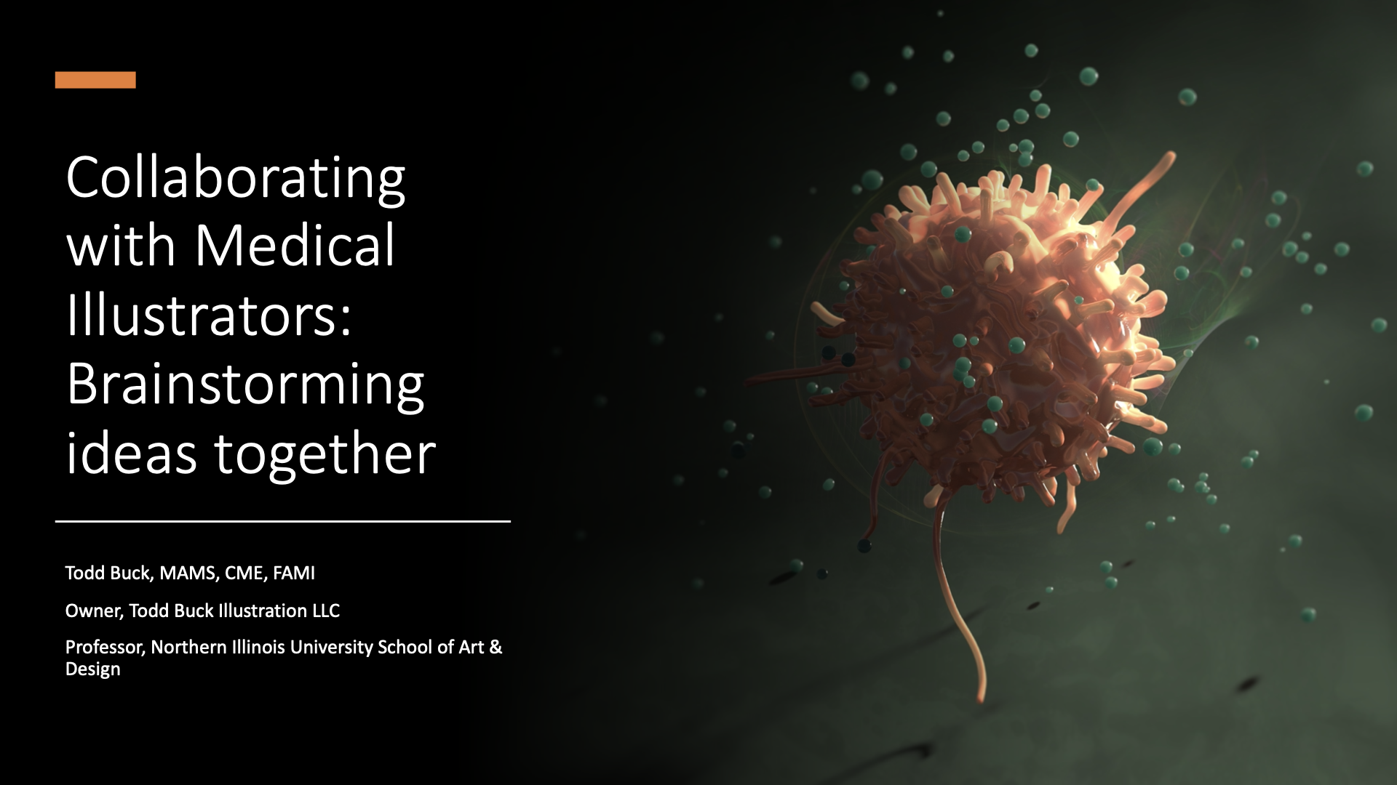
Collaborating with Medical illustrators
Todd Buck, MAMS, CME, FAMI
Owner, Todd Buck Illustration LLC
Professor, Northern Illinois University School of Art & Design

Slide 2
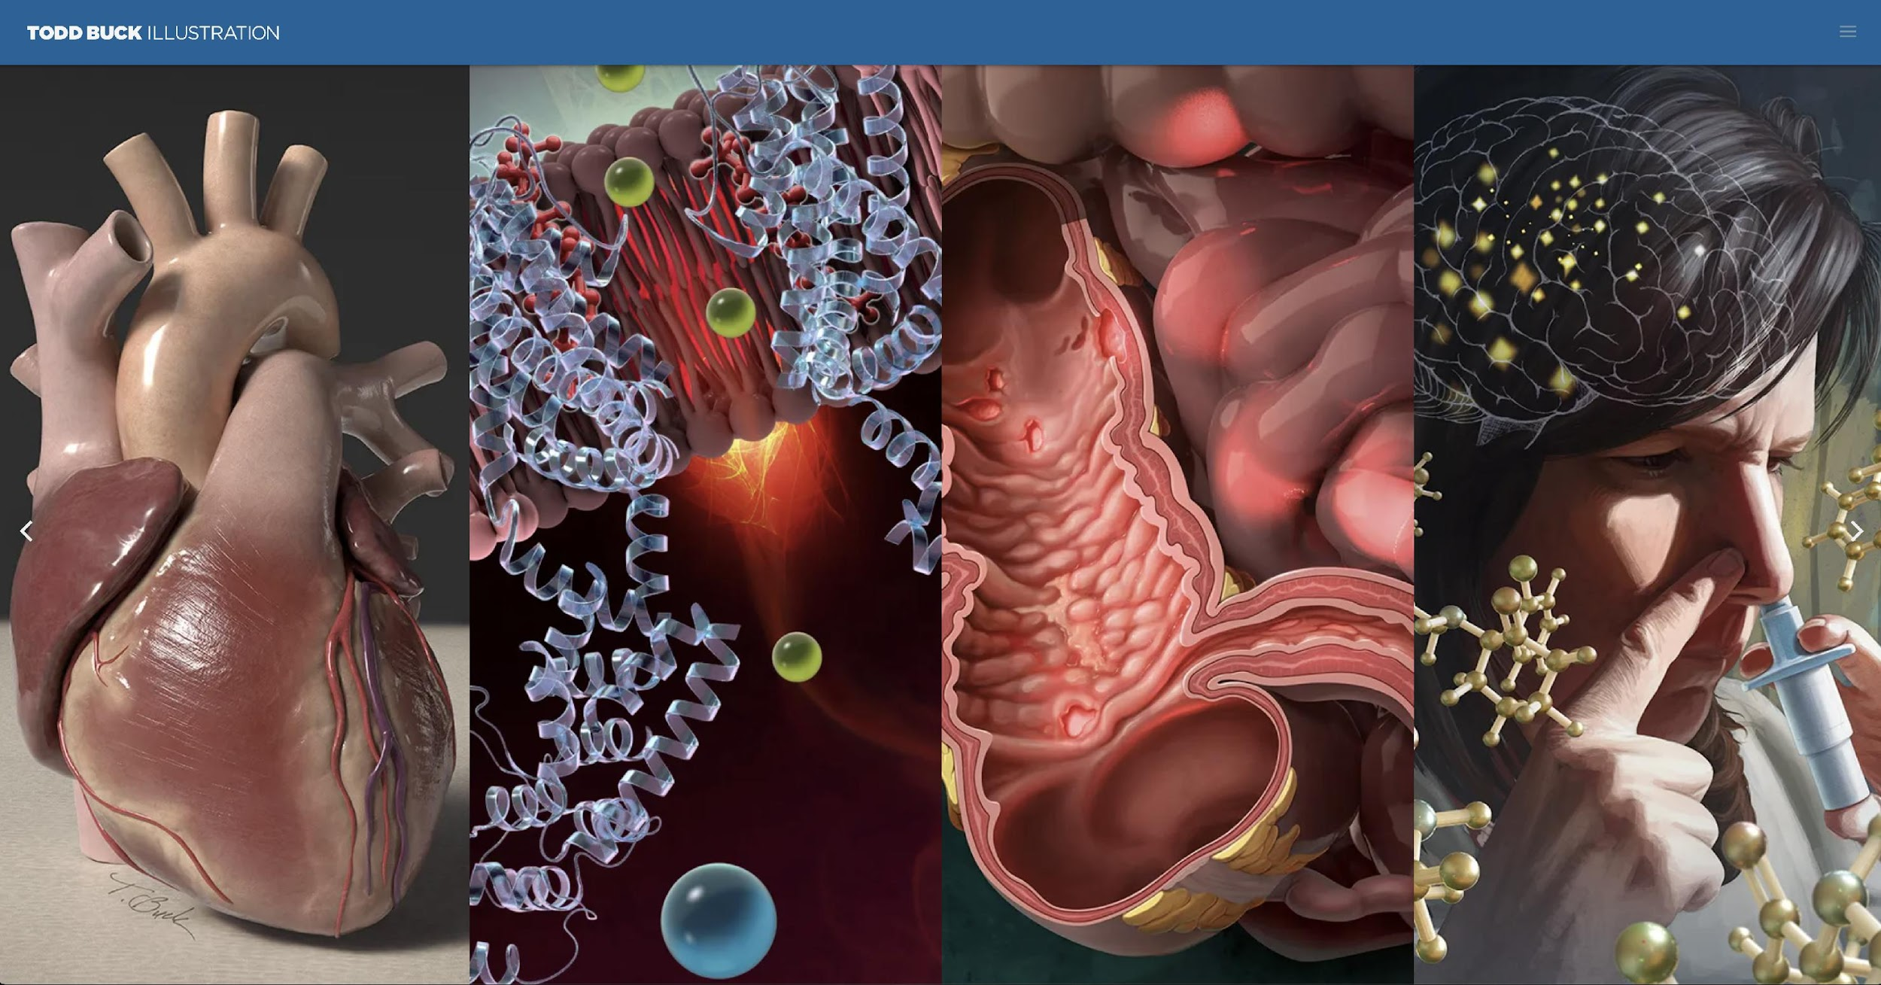
Todd Buck, MAMS, CMI, FAMI
Owner, Todd Buck Illustration LLC
Professor at Northern Illinois University School of Art and Design

Slide 3



Benefits of including quality images in your research, publications, grant applications, posters, and educational materials
Ability to explain complex subjects to non-experts (students, lay audience, end users, investors, etc.)
Visual learners engage with pictures.
Pictures grab attention and can summarize a lot of text in a digestible manner.

Slide 4
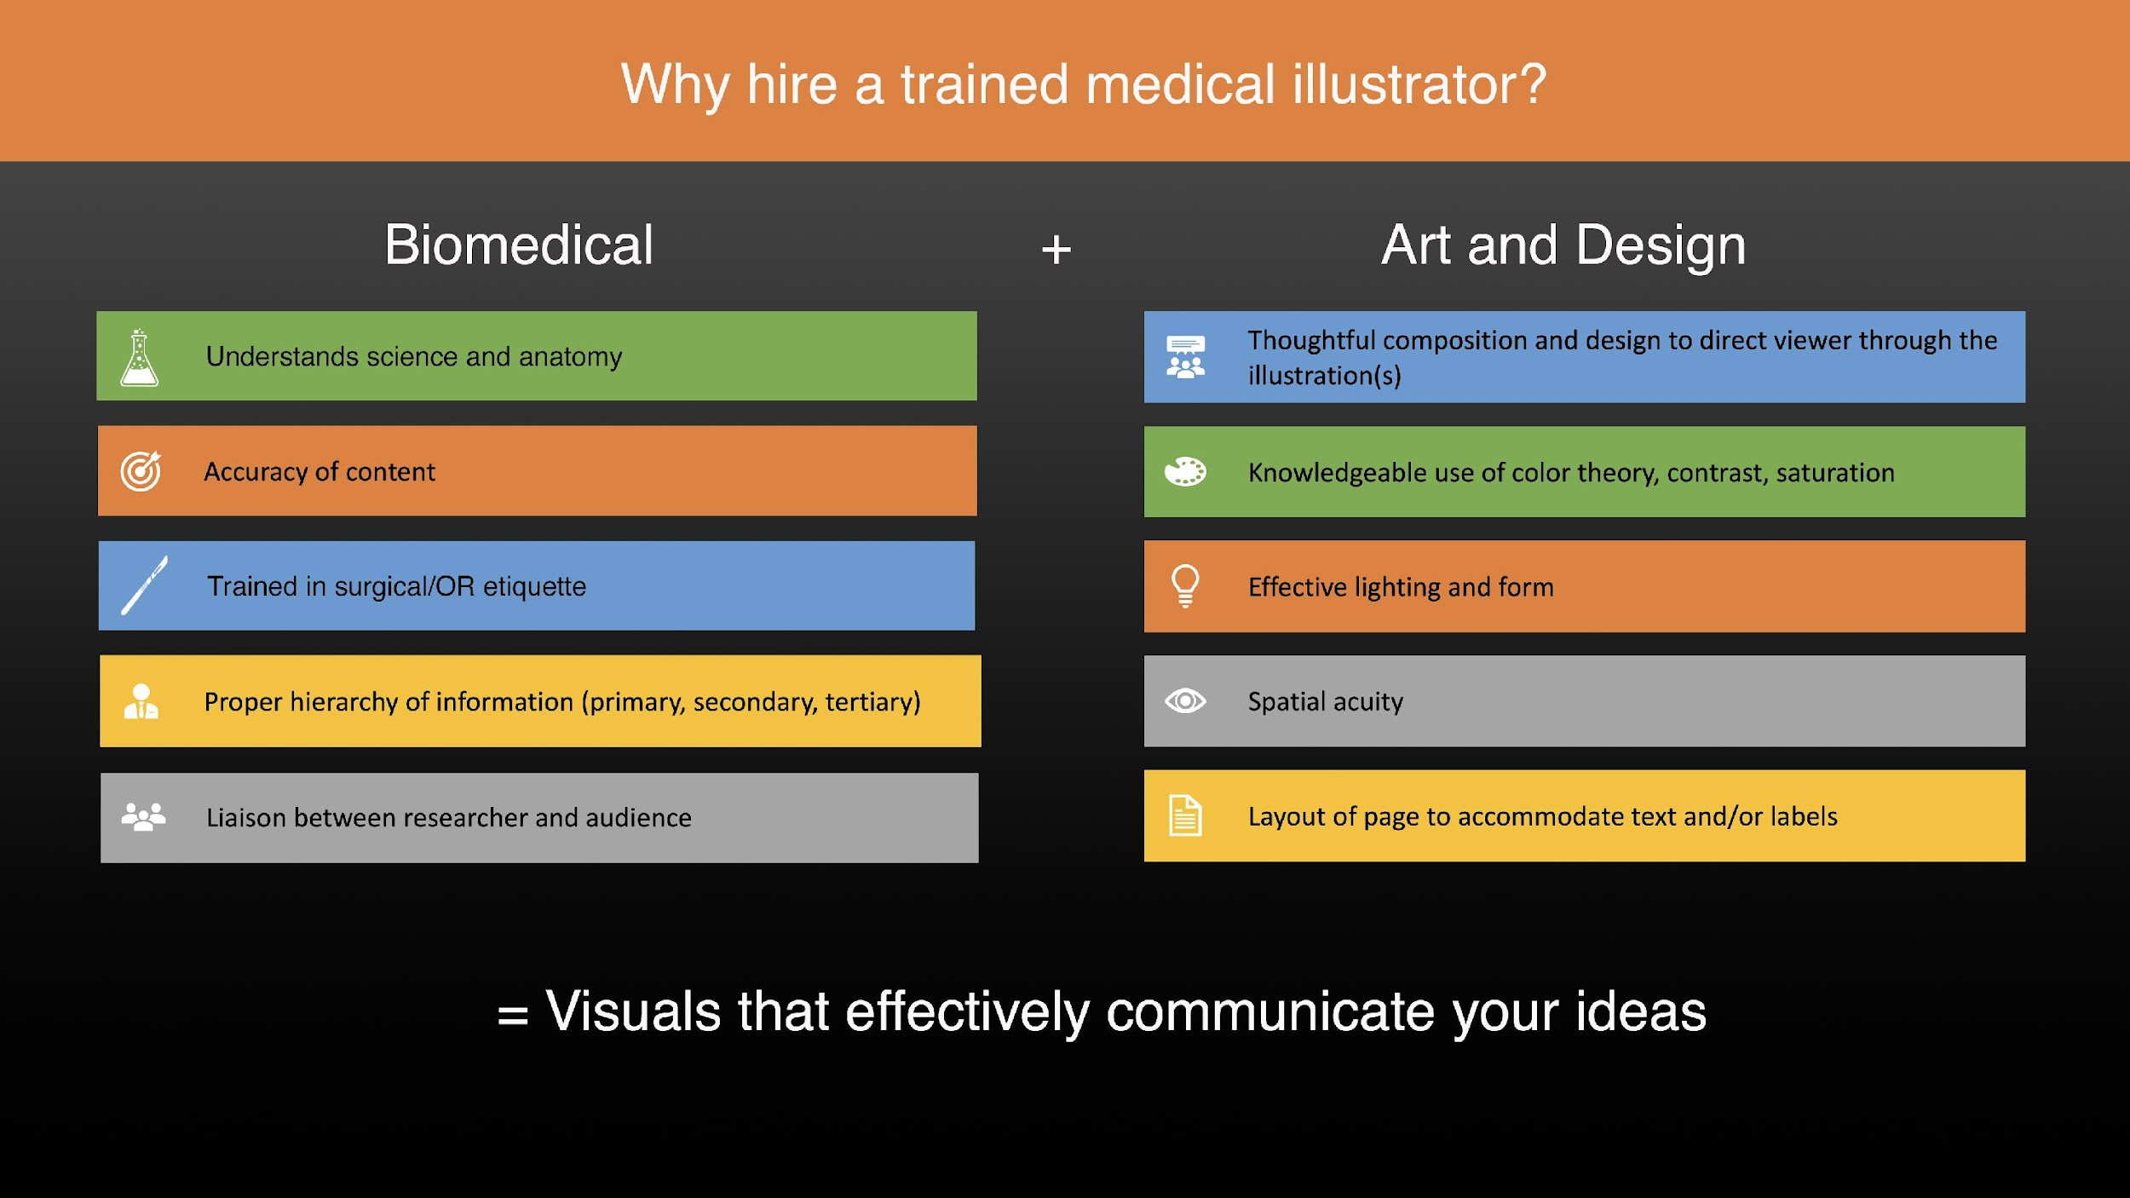
Notes:
Human gross anatomy, pathophysiology, histology, embryology, chemistry, organic chemistry, biochemistry, biology, zoology, comparative anatomy, plant taxonomy, ornithology, ecology, experience attending surgeries

Slide 5
Finding and contactingmedical illustrators
Medical Illustration and Animation Sourcebook (medillsb.com)
“Find a Medical Illustrator” through AMI.org
Send email with your contact info and affiliated institution/company
Brief description of project and deadline; detailed info once you connect

Slide 6







Illustrator provides cost and time estimate based on answers to the following questions
What are the illustrations for?
What is your deadline?
What size and format will the work be printed or displayed? (dimensions, resolution)
How many illustrations? (or how many seconds of animation?)
Any samples of what you like or that show similar complexity of content?
Who is the intended audience?
What rights would you like to purchase?

Slide 7
Consider Target Audience
Education/Experience level
  Patient Education
  Peers
  Investors
  College-level students
  Surgeons
Demographics
  Diversity of representation (age, race, sex, etc.)
  Cultural influences

Slide 8
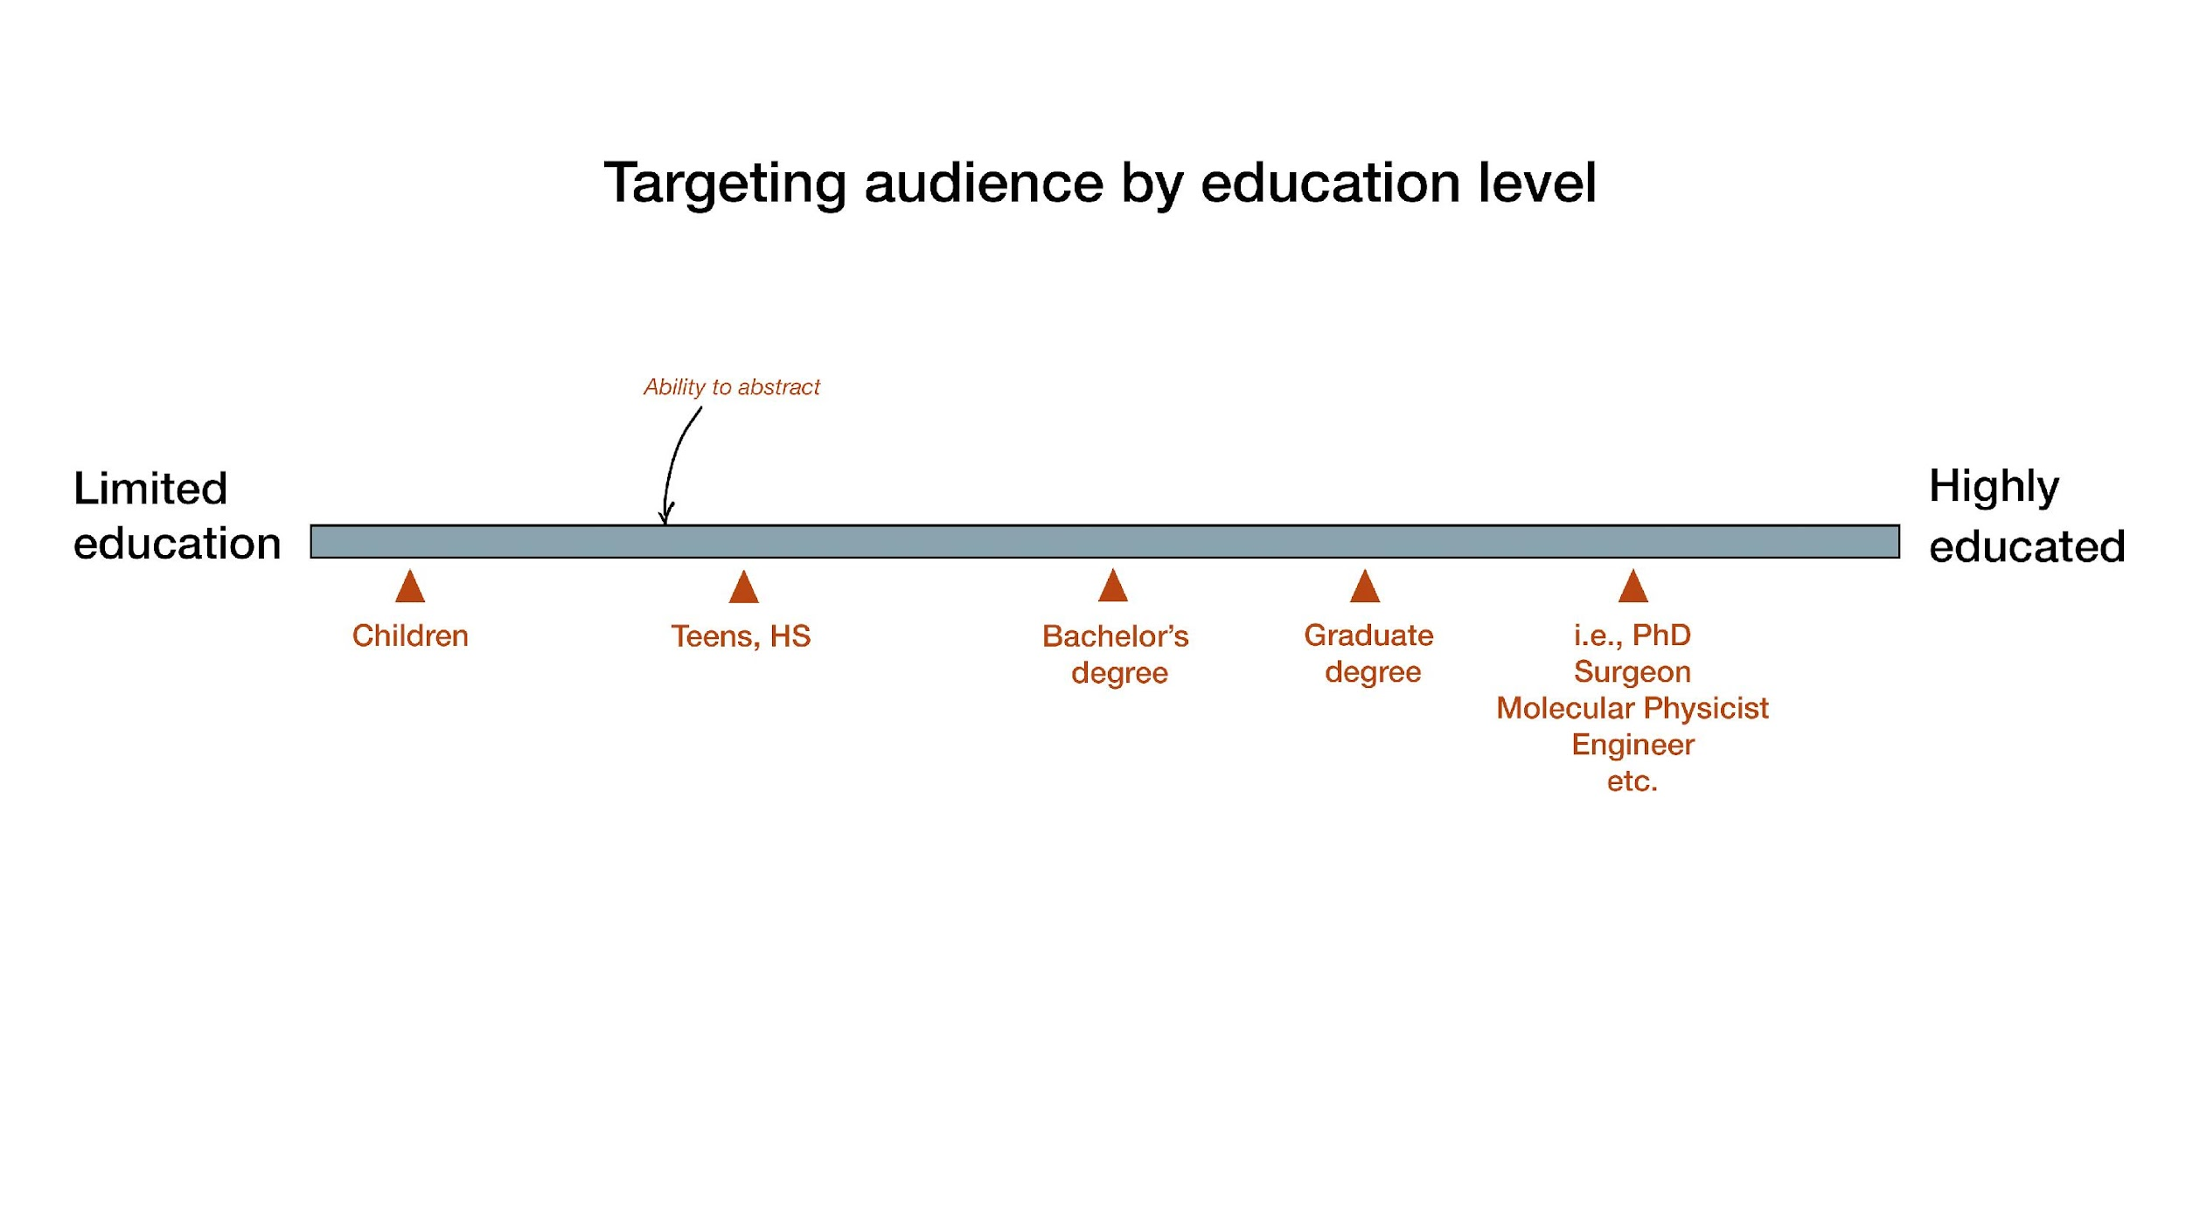

Slide 9
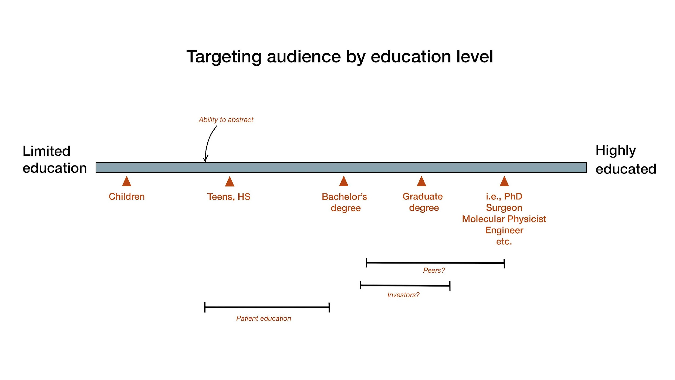

Slide 10




Simple vs Moderate vs Complex Illustrations
Cost
Time
Research
Audience
Size
Notes:
Simple = less of each of these.
Research: Is it a complex story requiring days of research or is it relatively easy to understand and express visually? Will it require illustrator attending surgeries?
Size: ¼ page, full page cover art, 2-page spread, poster, web?

Slide 11
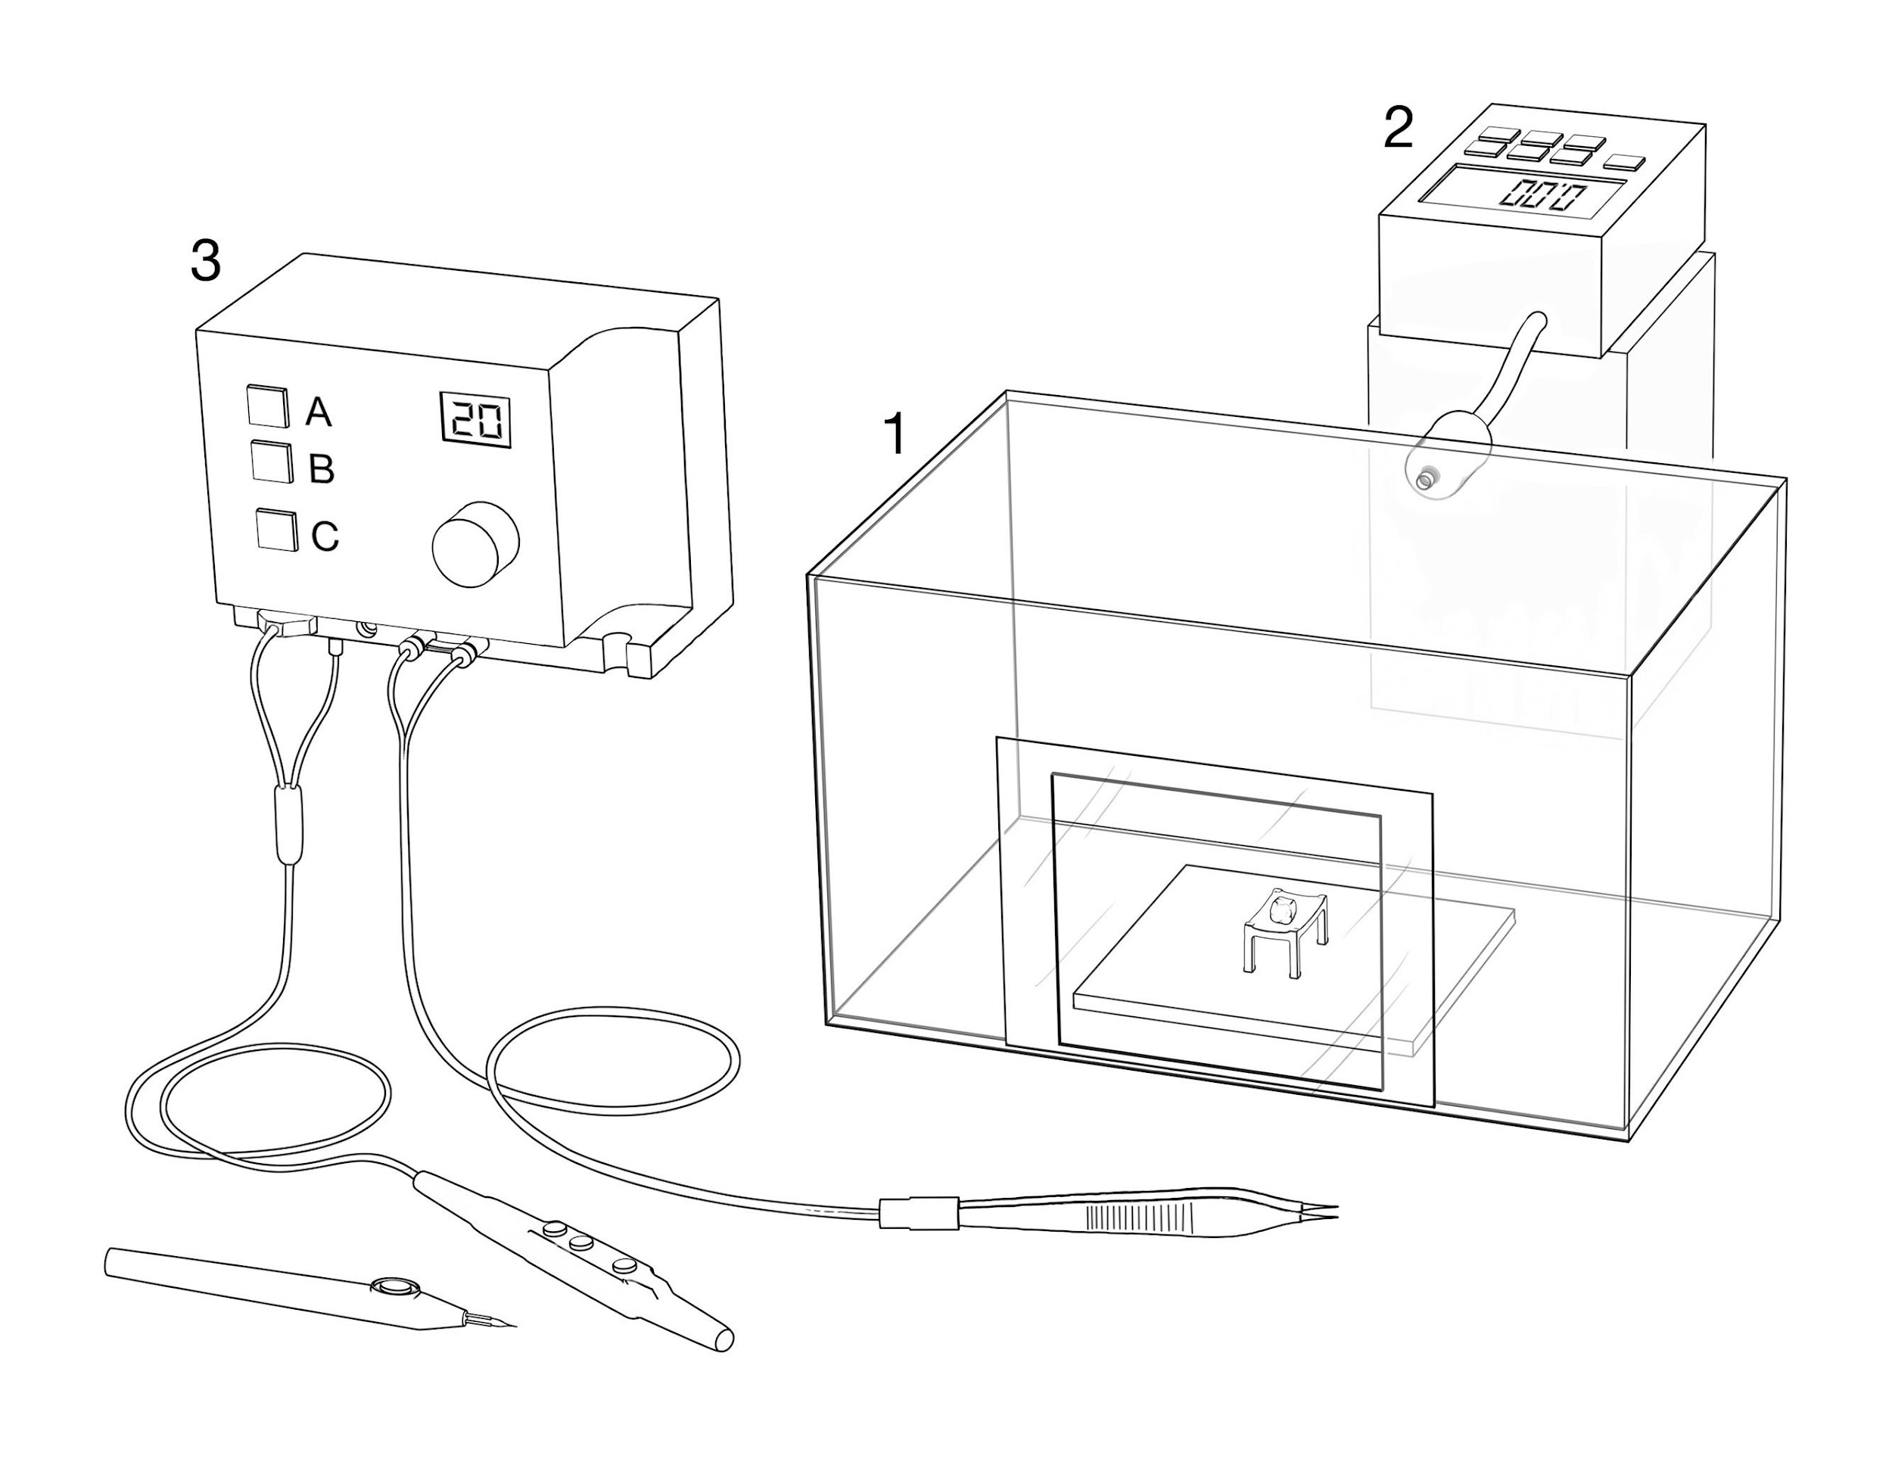
Simple

Slide 12
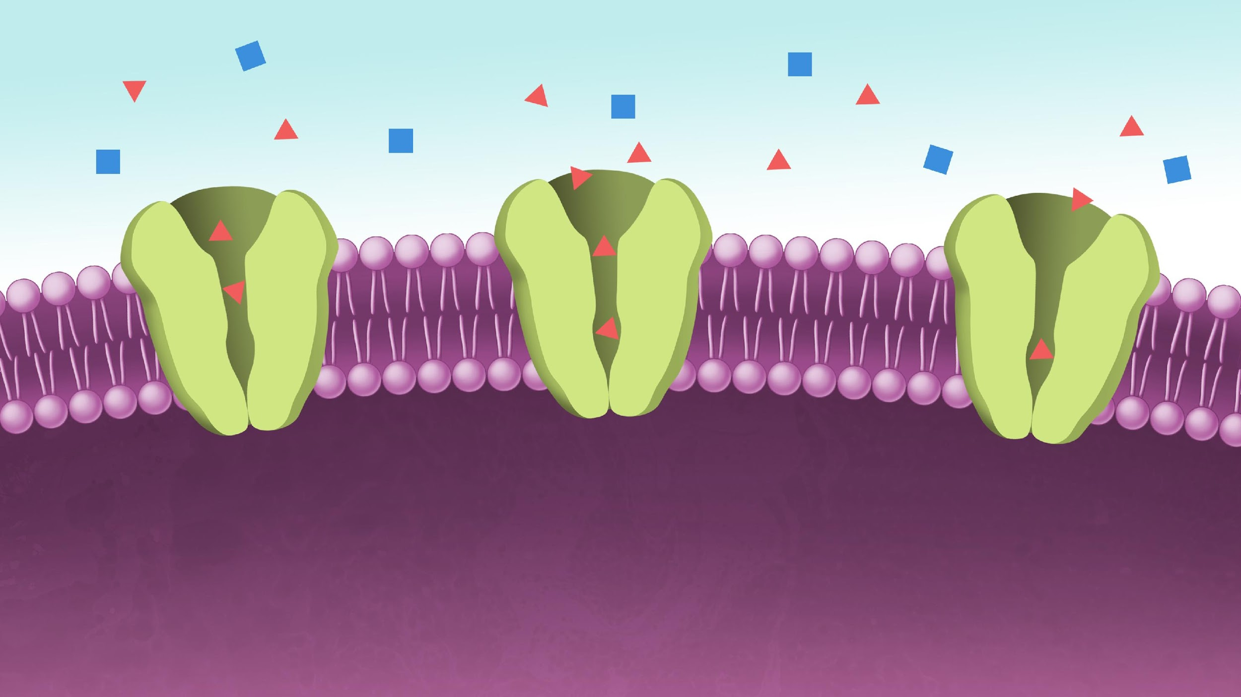
Simple

Slide 13
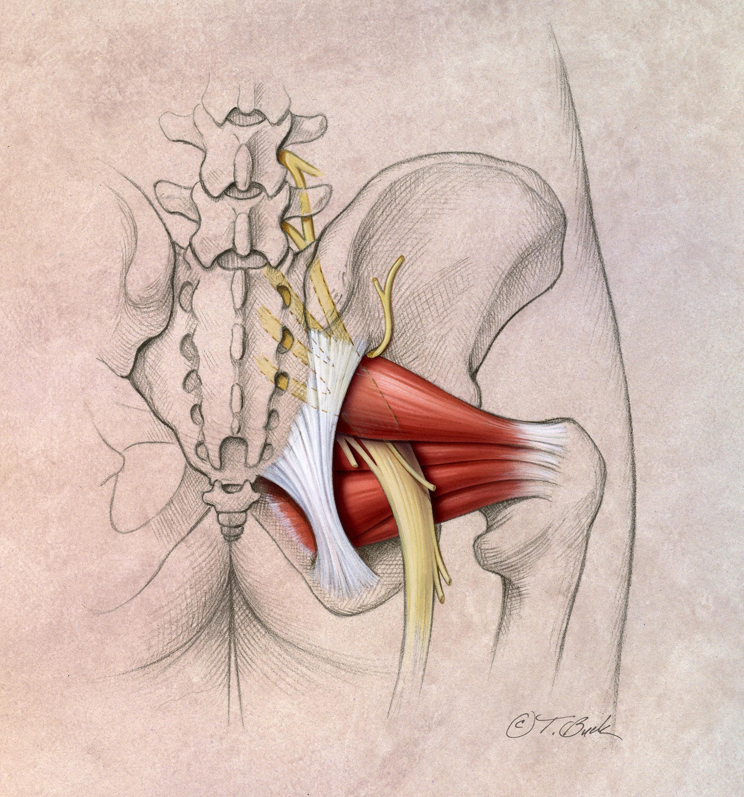
Moderate

Slide 14
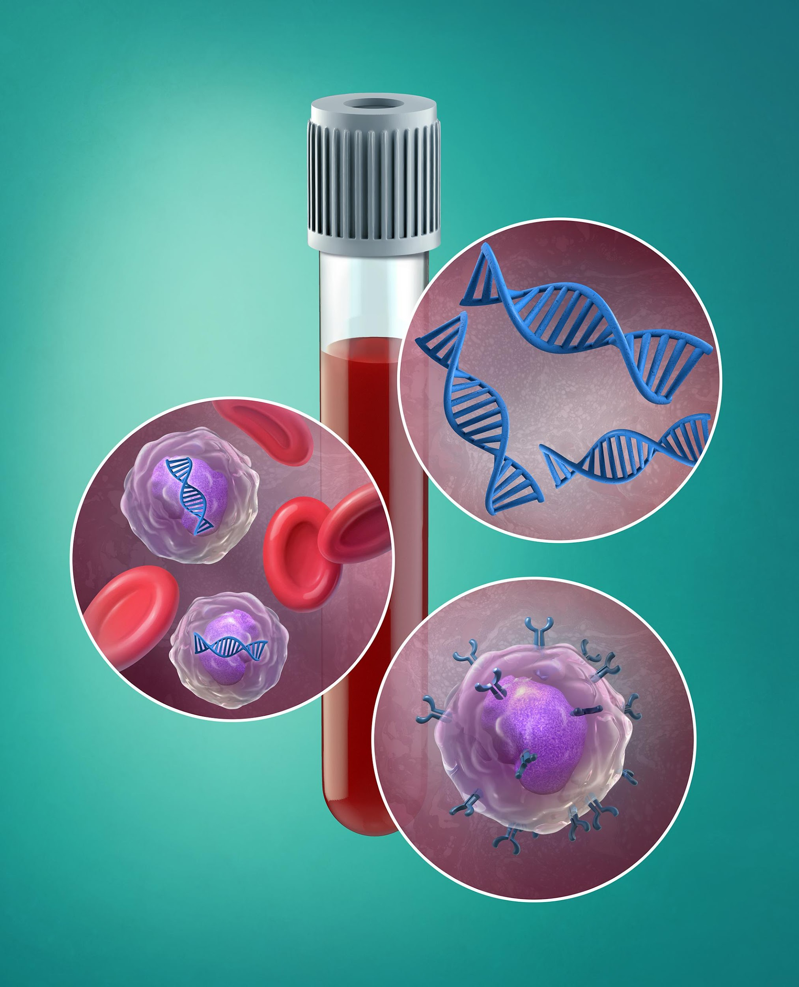
Moderate

Slide 15
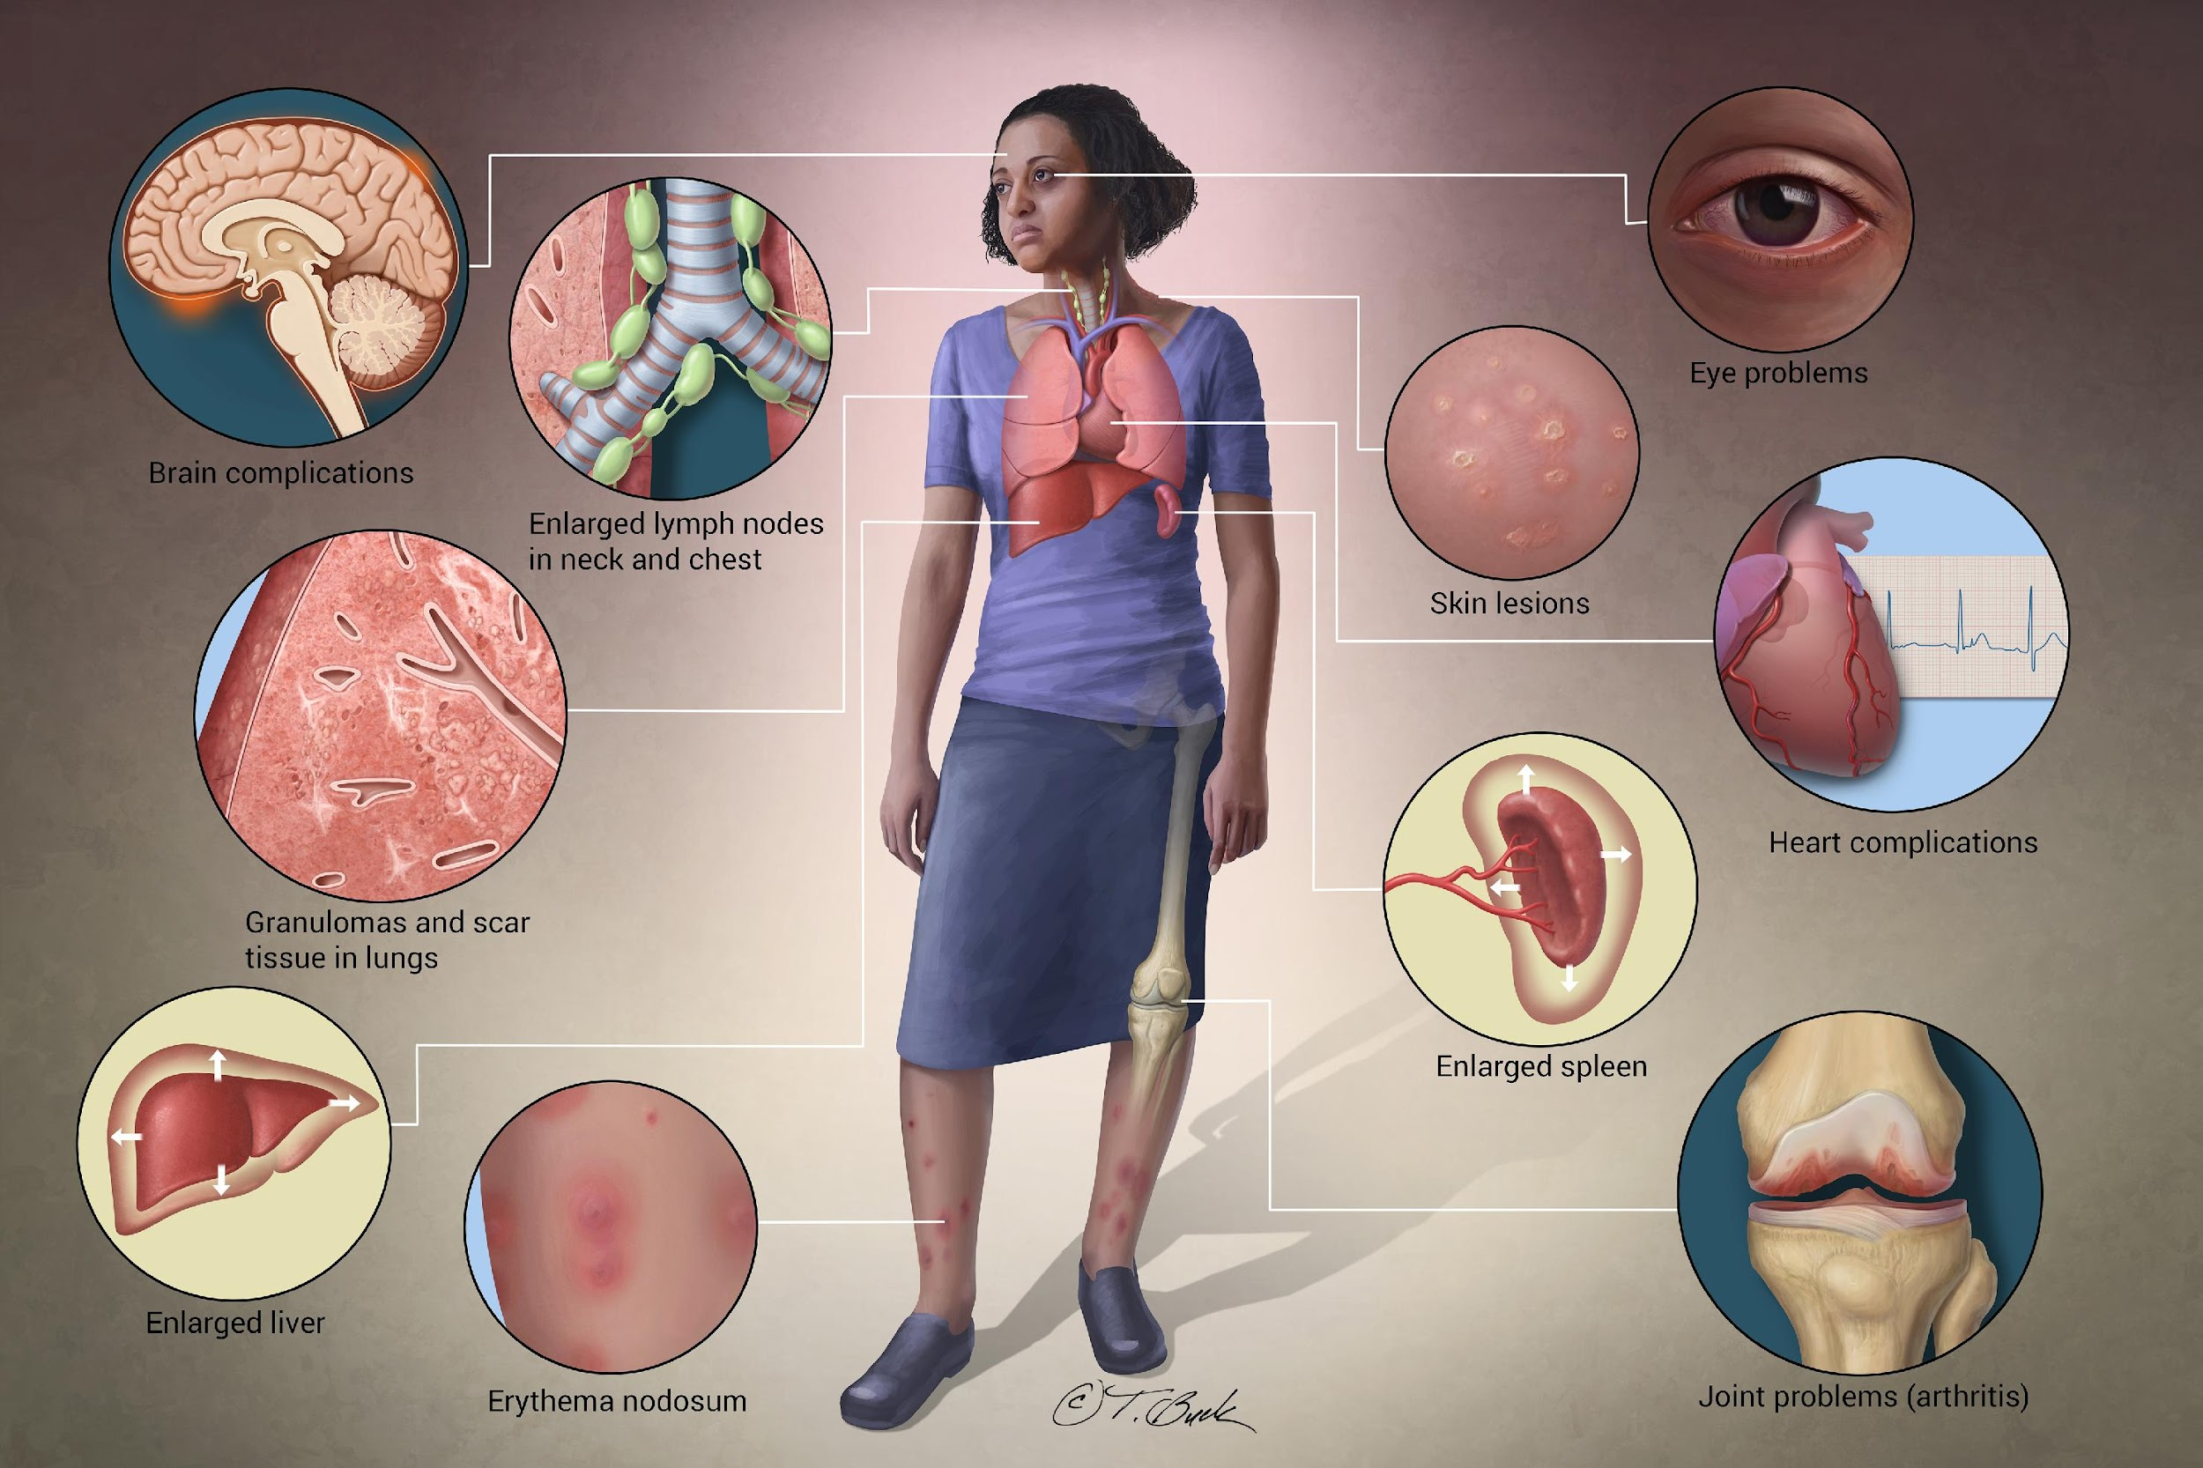
Complex

Slide 16
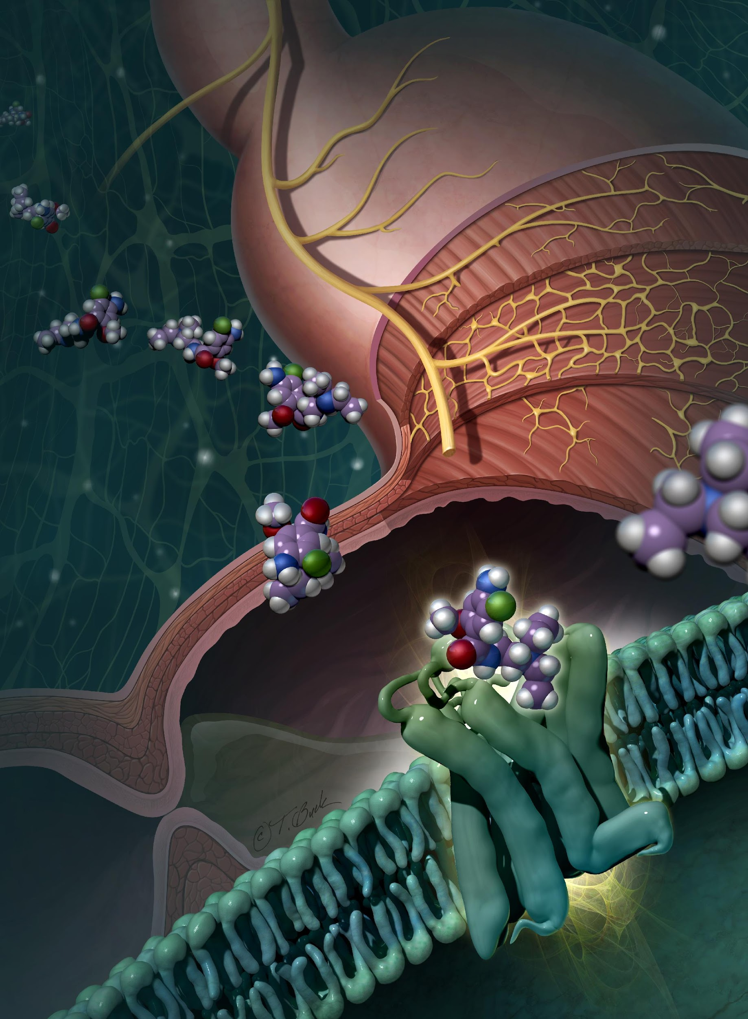
Complex

Slide 17
How many illustrations are you really requesting?

Slide 18
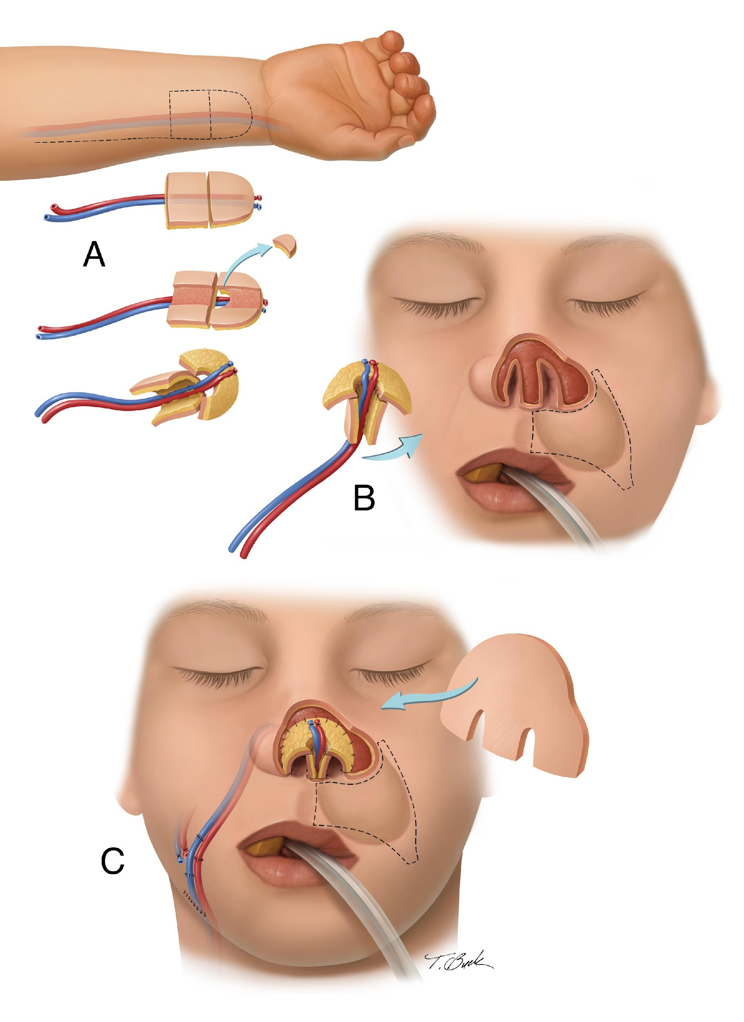

Slide 19
Interdisciplinary Collaborations at NIU
Engineering Department
  Grant applications
  Industrial Design – student teams
Biological Sciences Department
  Publication
  Student experience

Slide 20
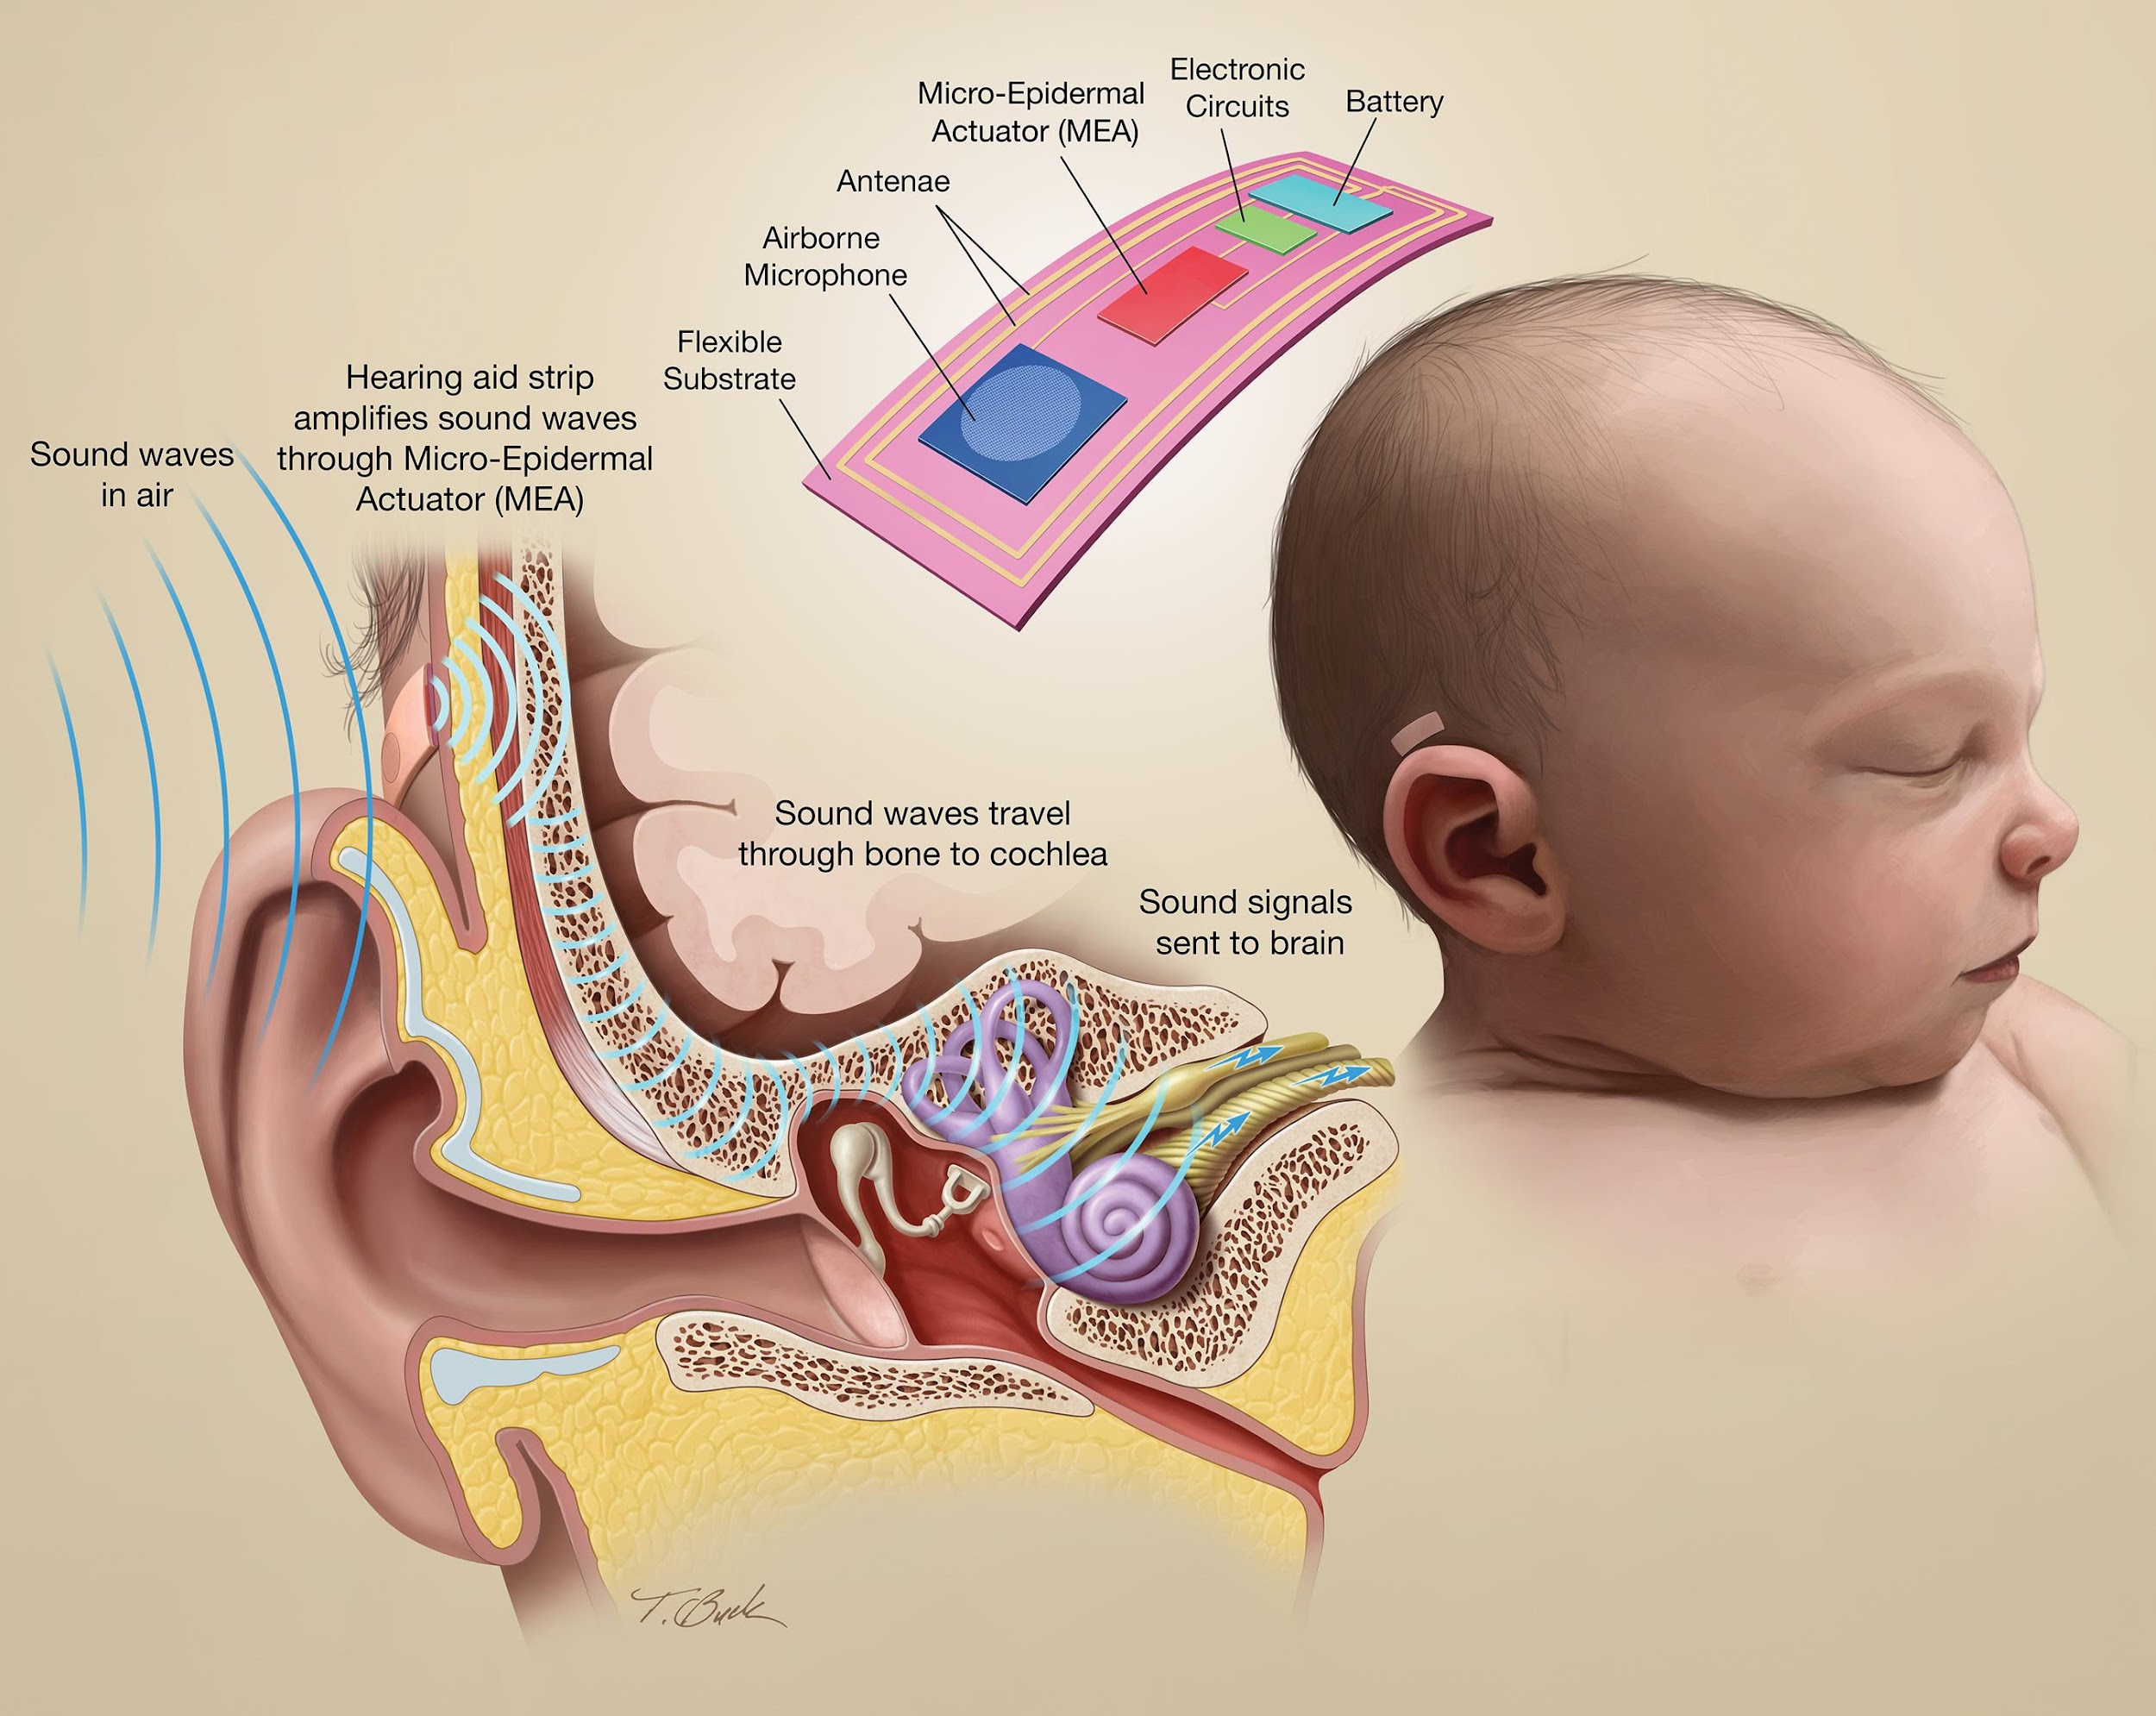
Non-invasive Hearing Aid illustration for Electrical Engineering Professor’s grant application – Awarded $430,000 NIH grant

Slide 21
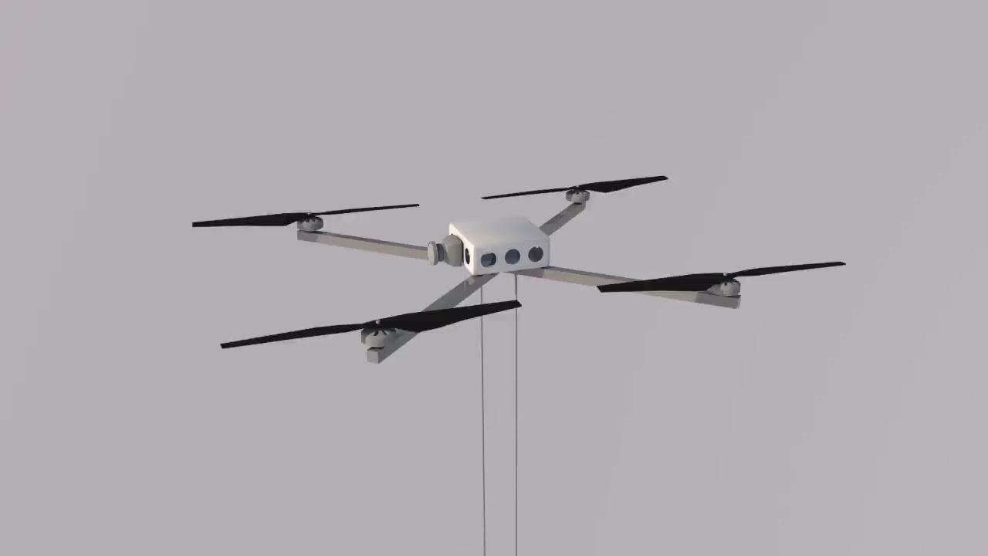
Remote Piloted Drone for Cenote Water Collection
Animation by BFA student Nestor Alvarez-Popoca

Slide 22
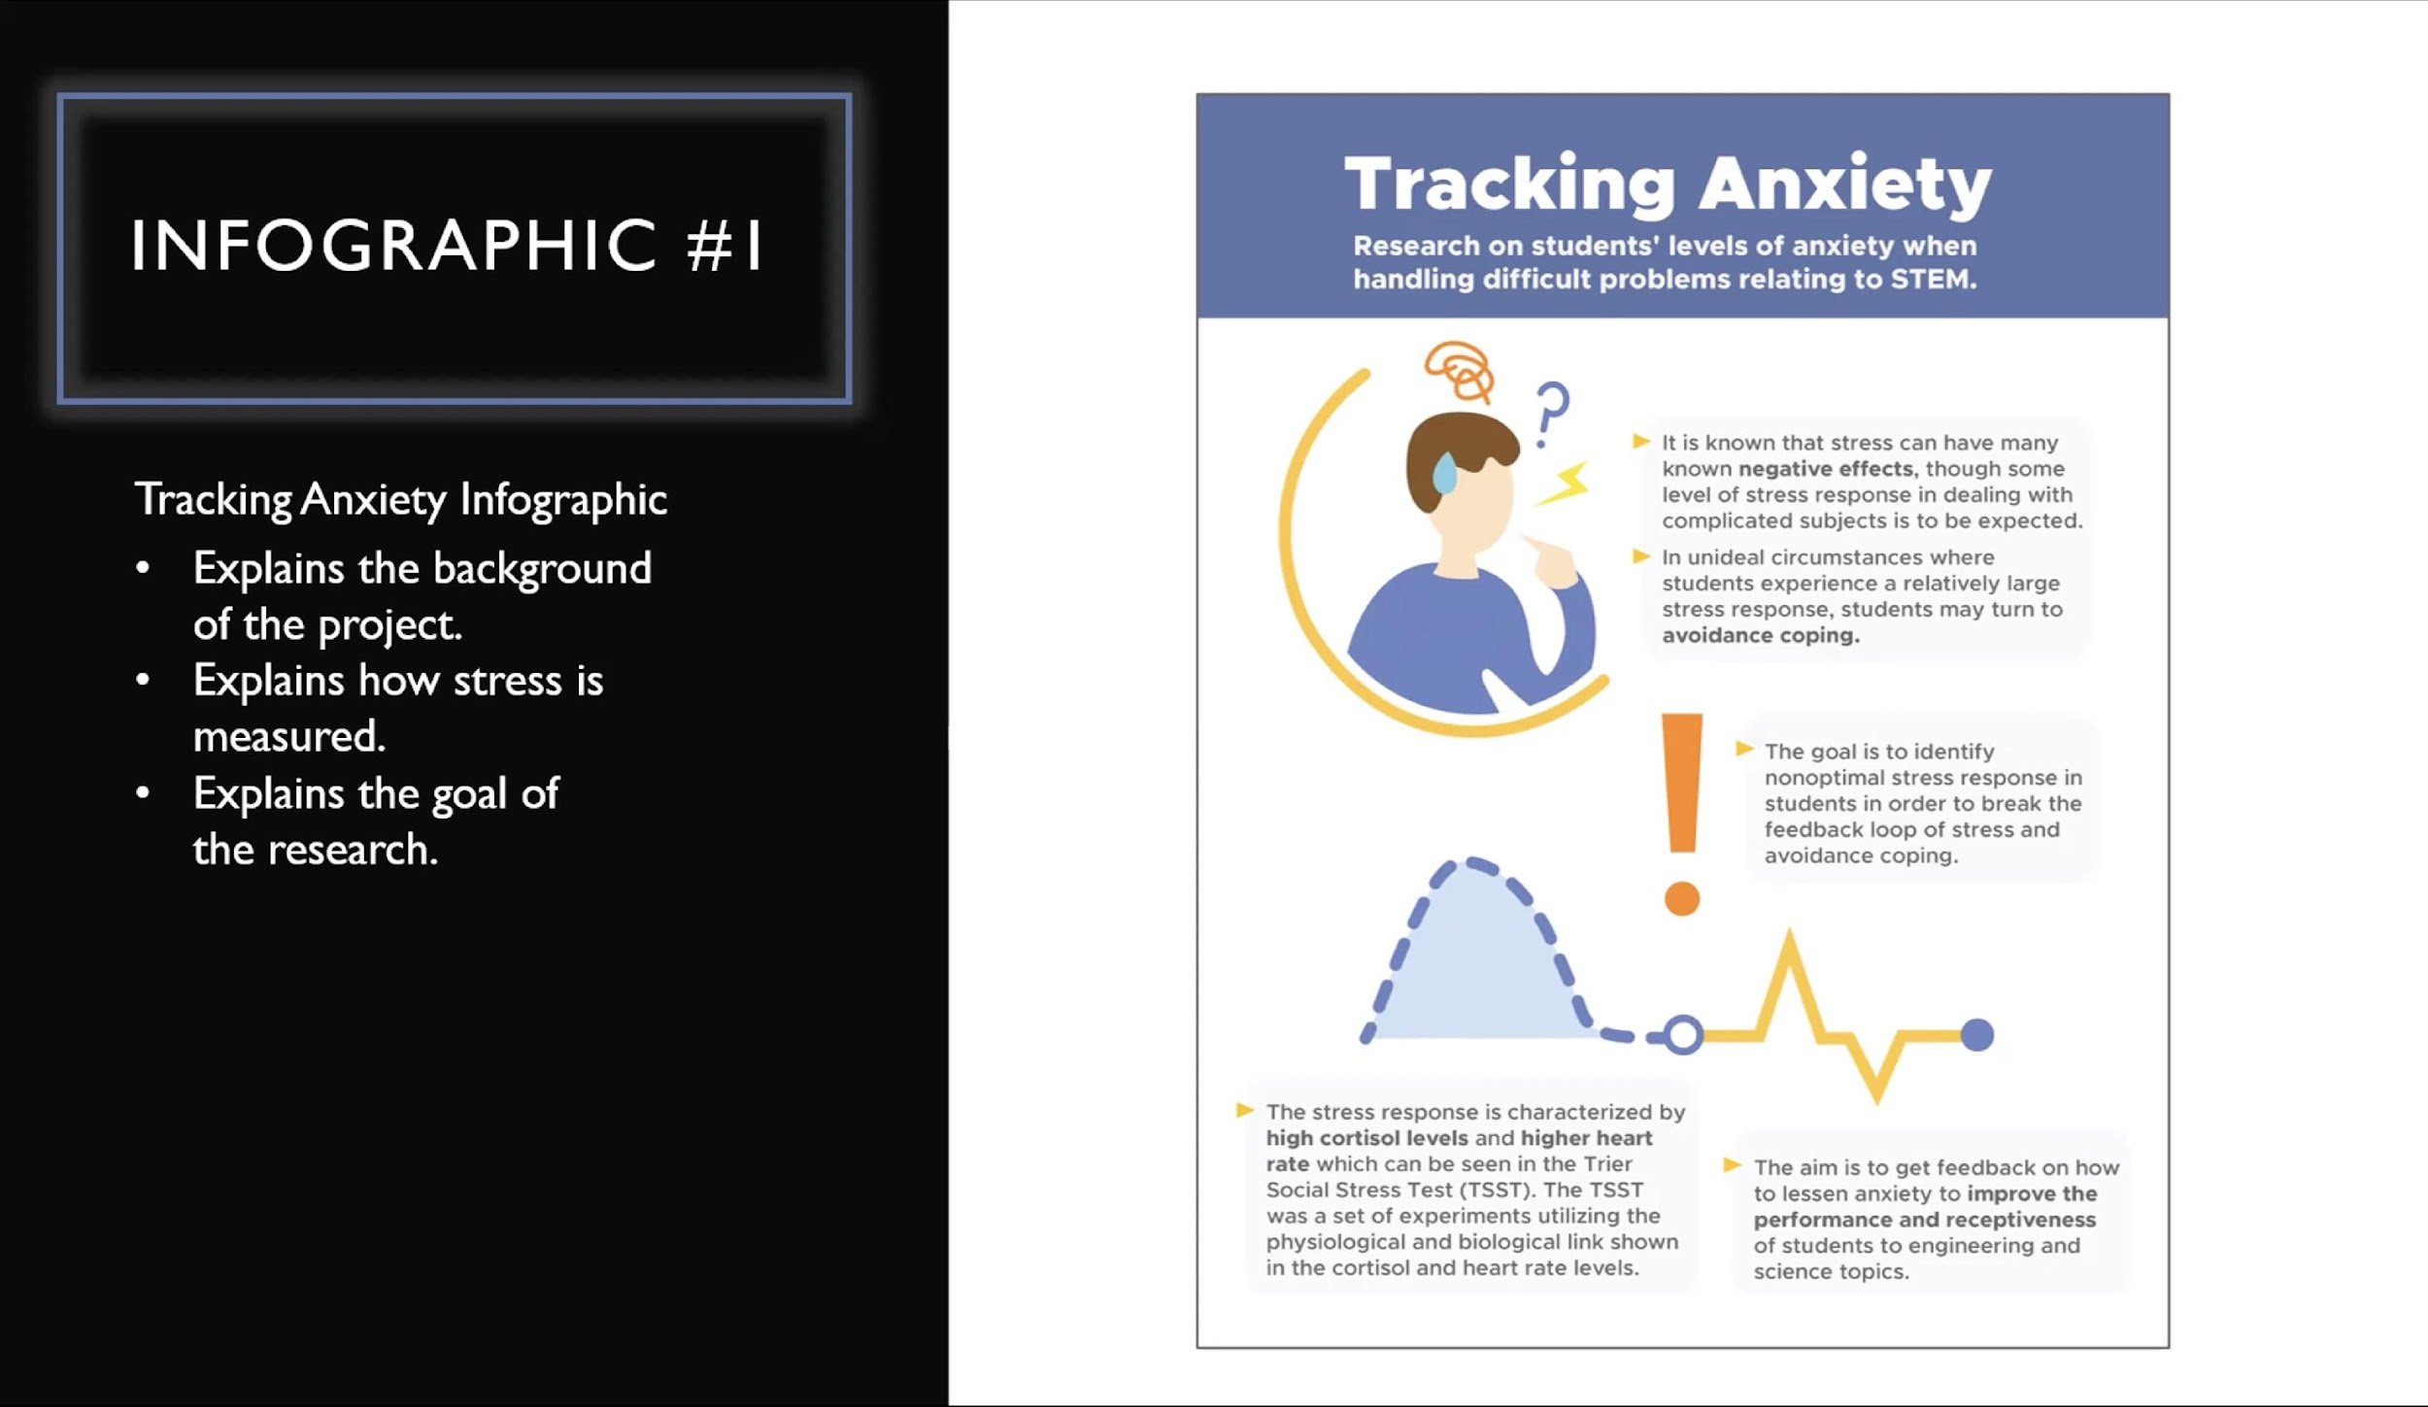
Development of a Wearable System to Track Anxiety Level
Infographic by Design Student Sarah Muszanski

Slide 23
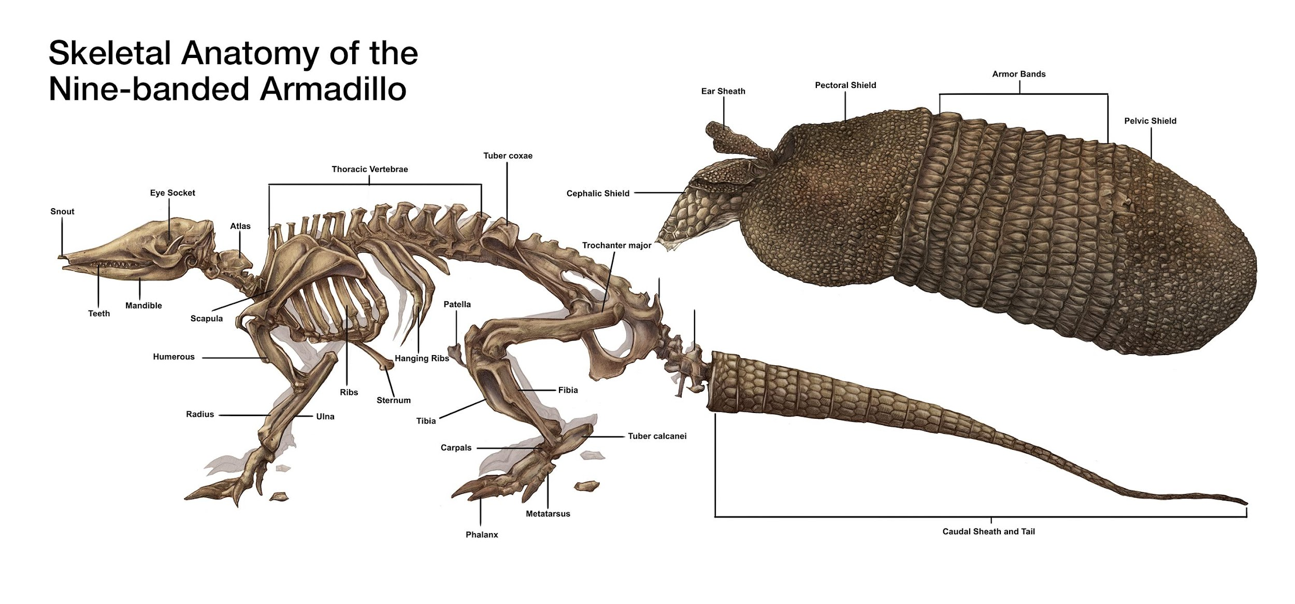
Illustration for Biology Professor by BFA student Michael Vitha-Nolan

Slide 24
True collaboration between client and illustrator is fun and involves brainstorming ideas together

Slide 25
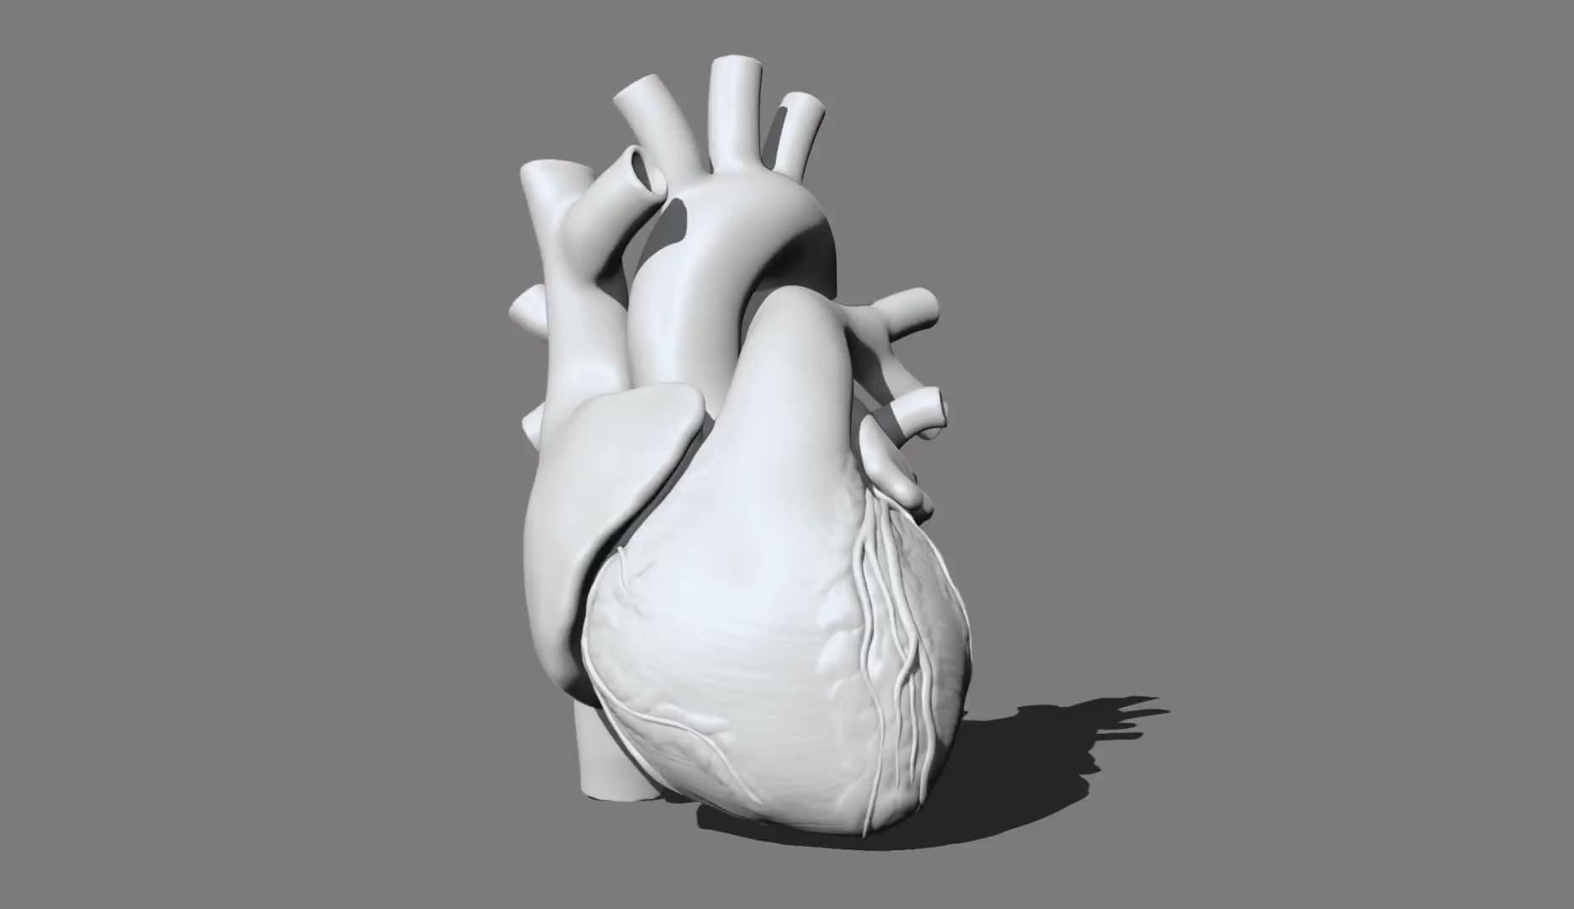

Slide 26
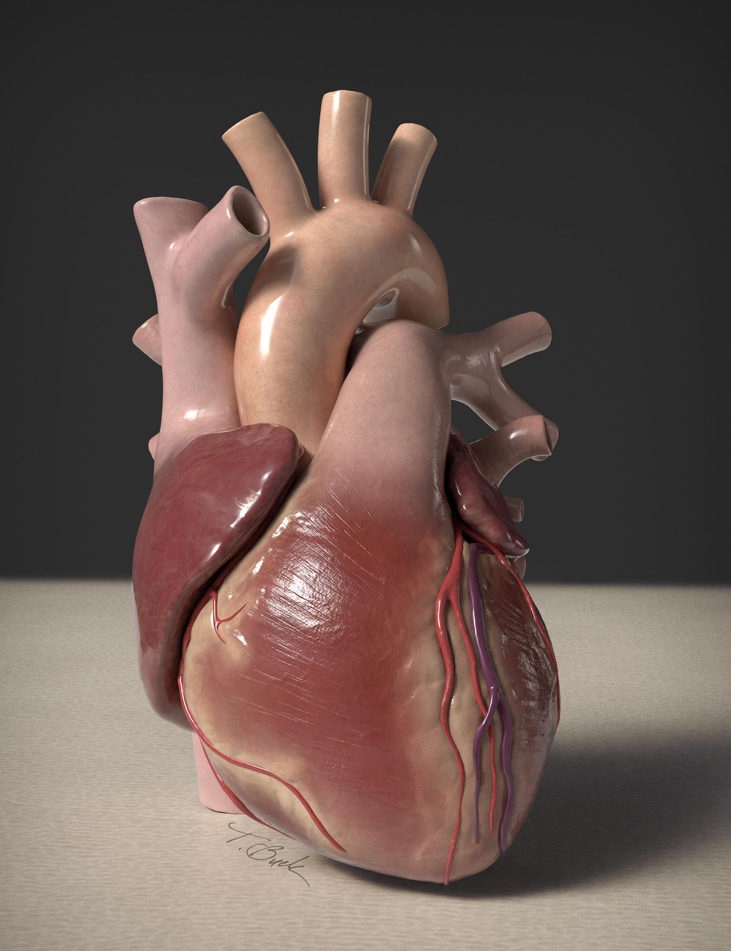

Slide 27
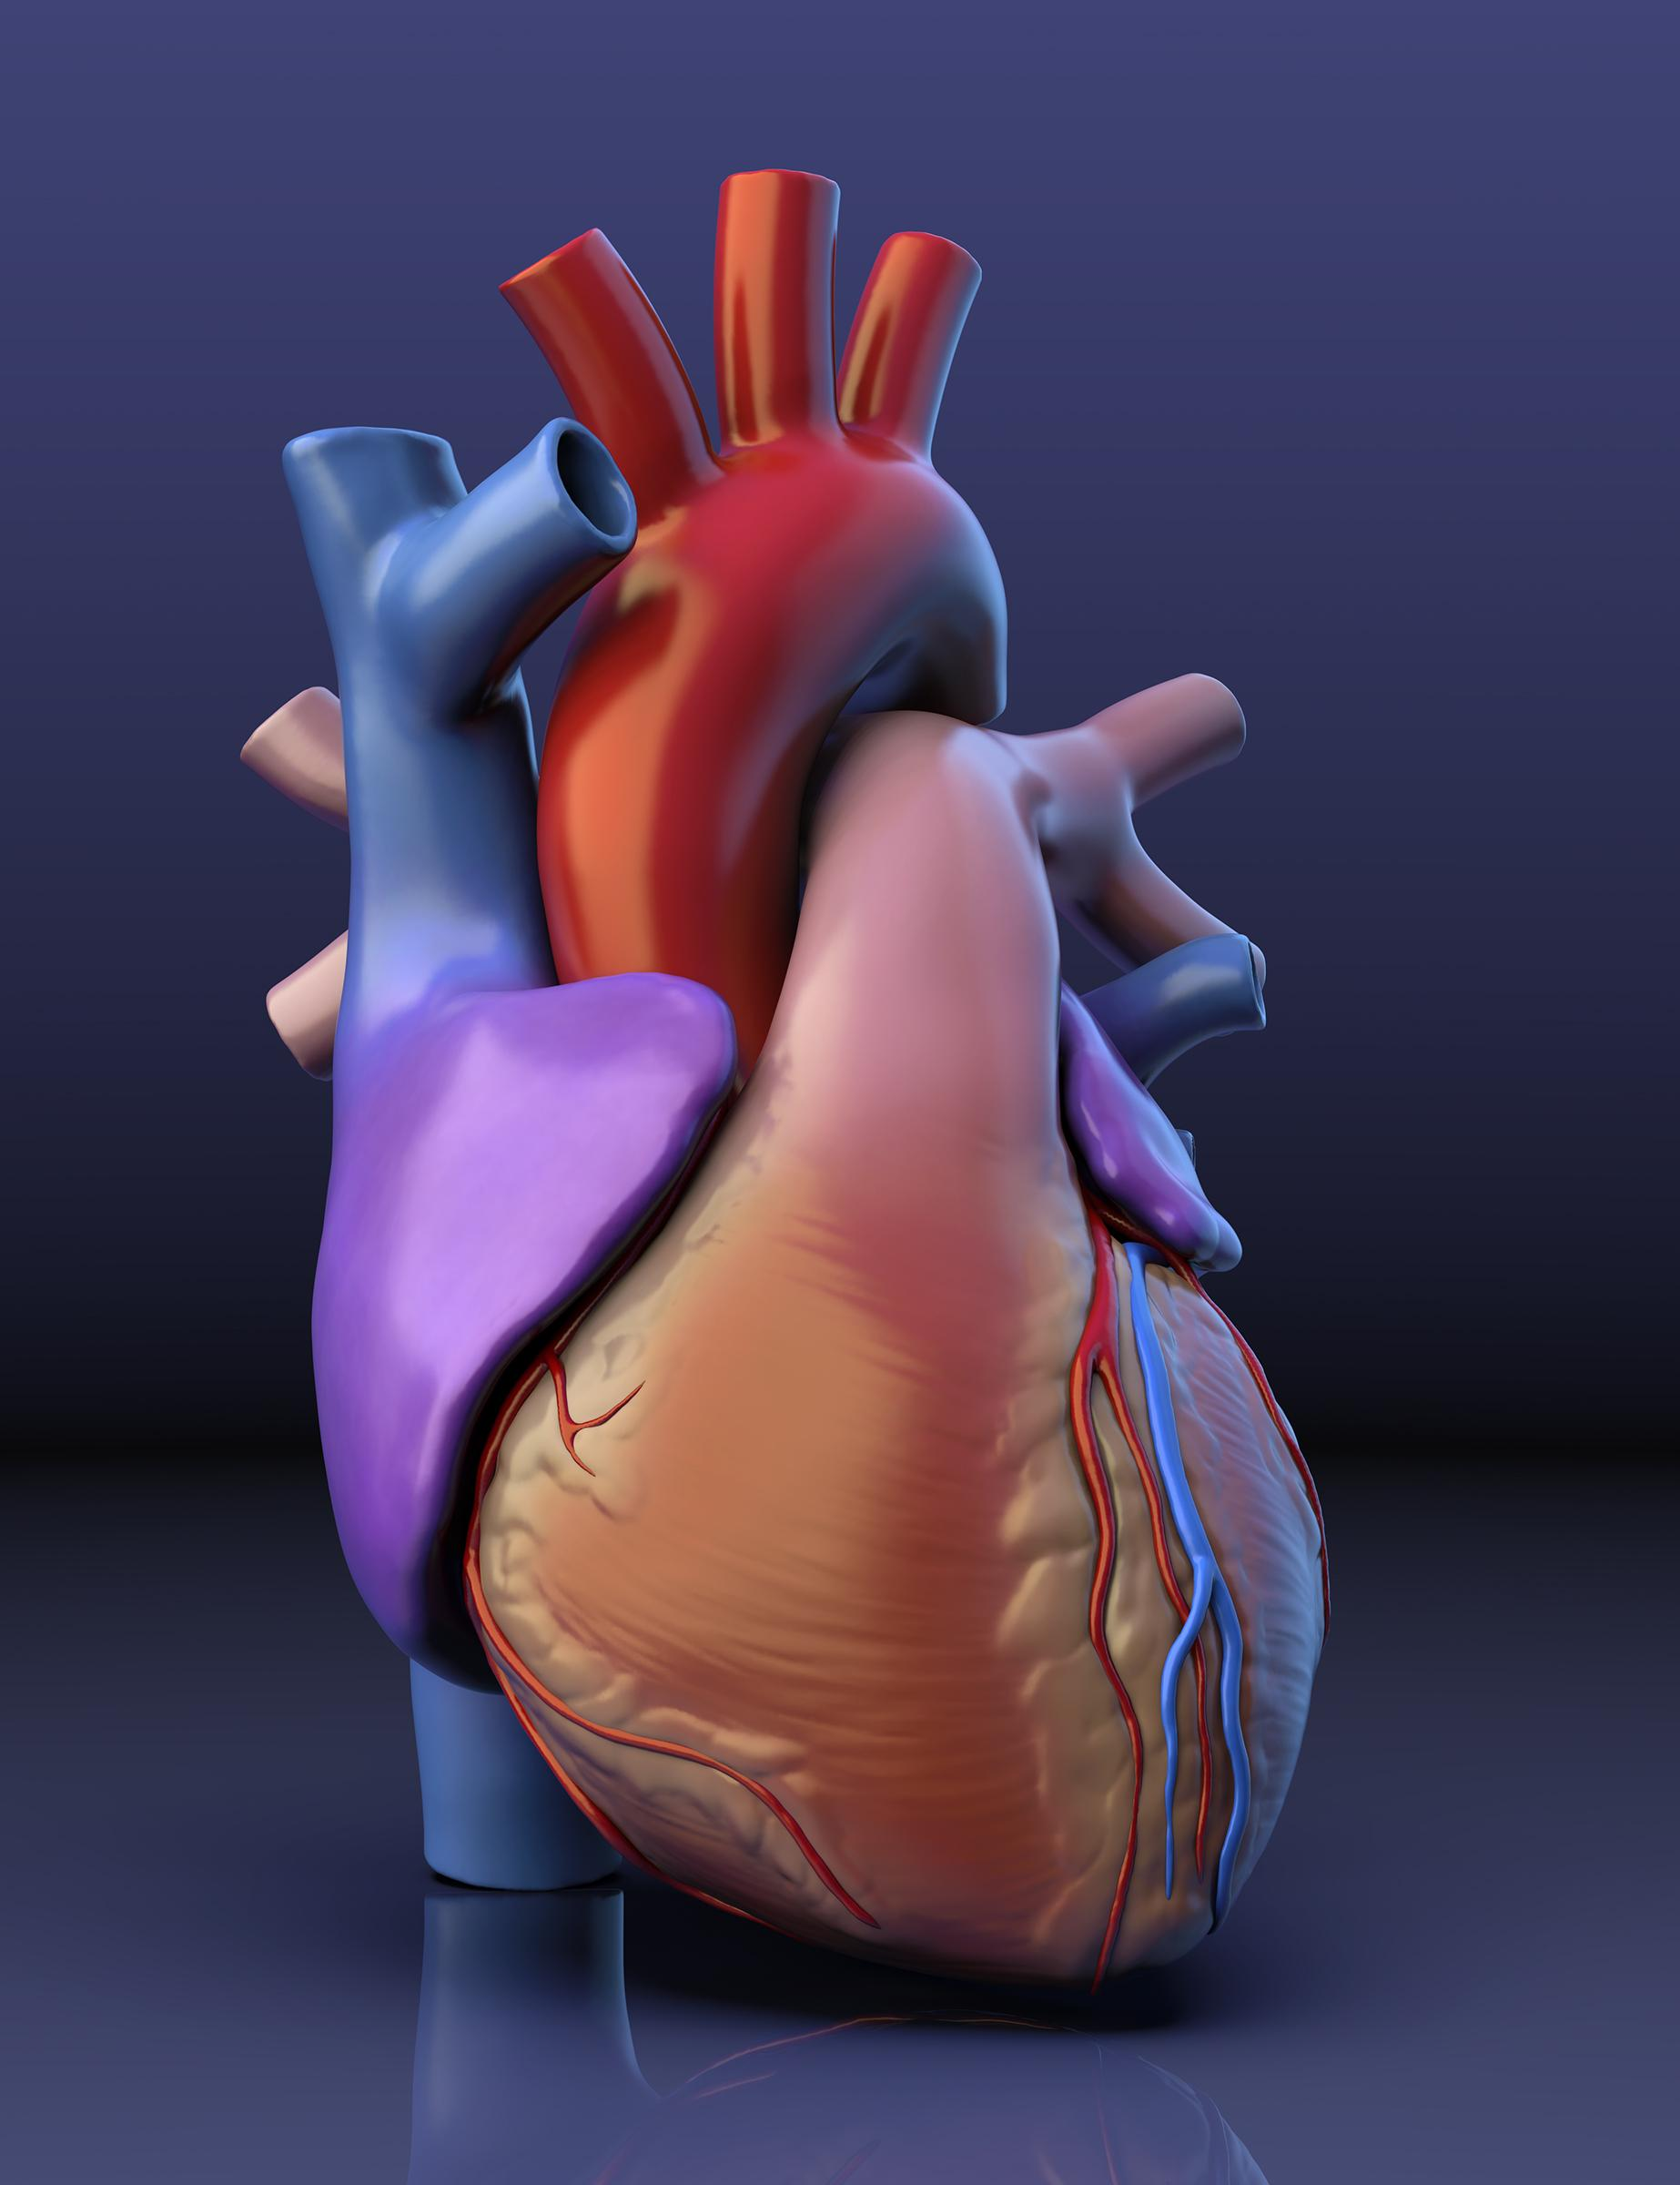

Slide 28
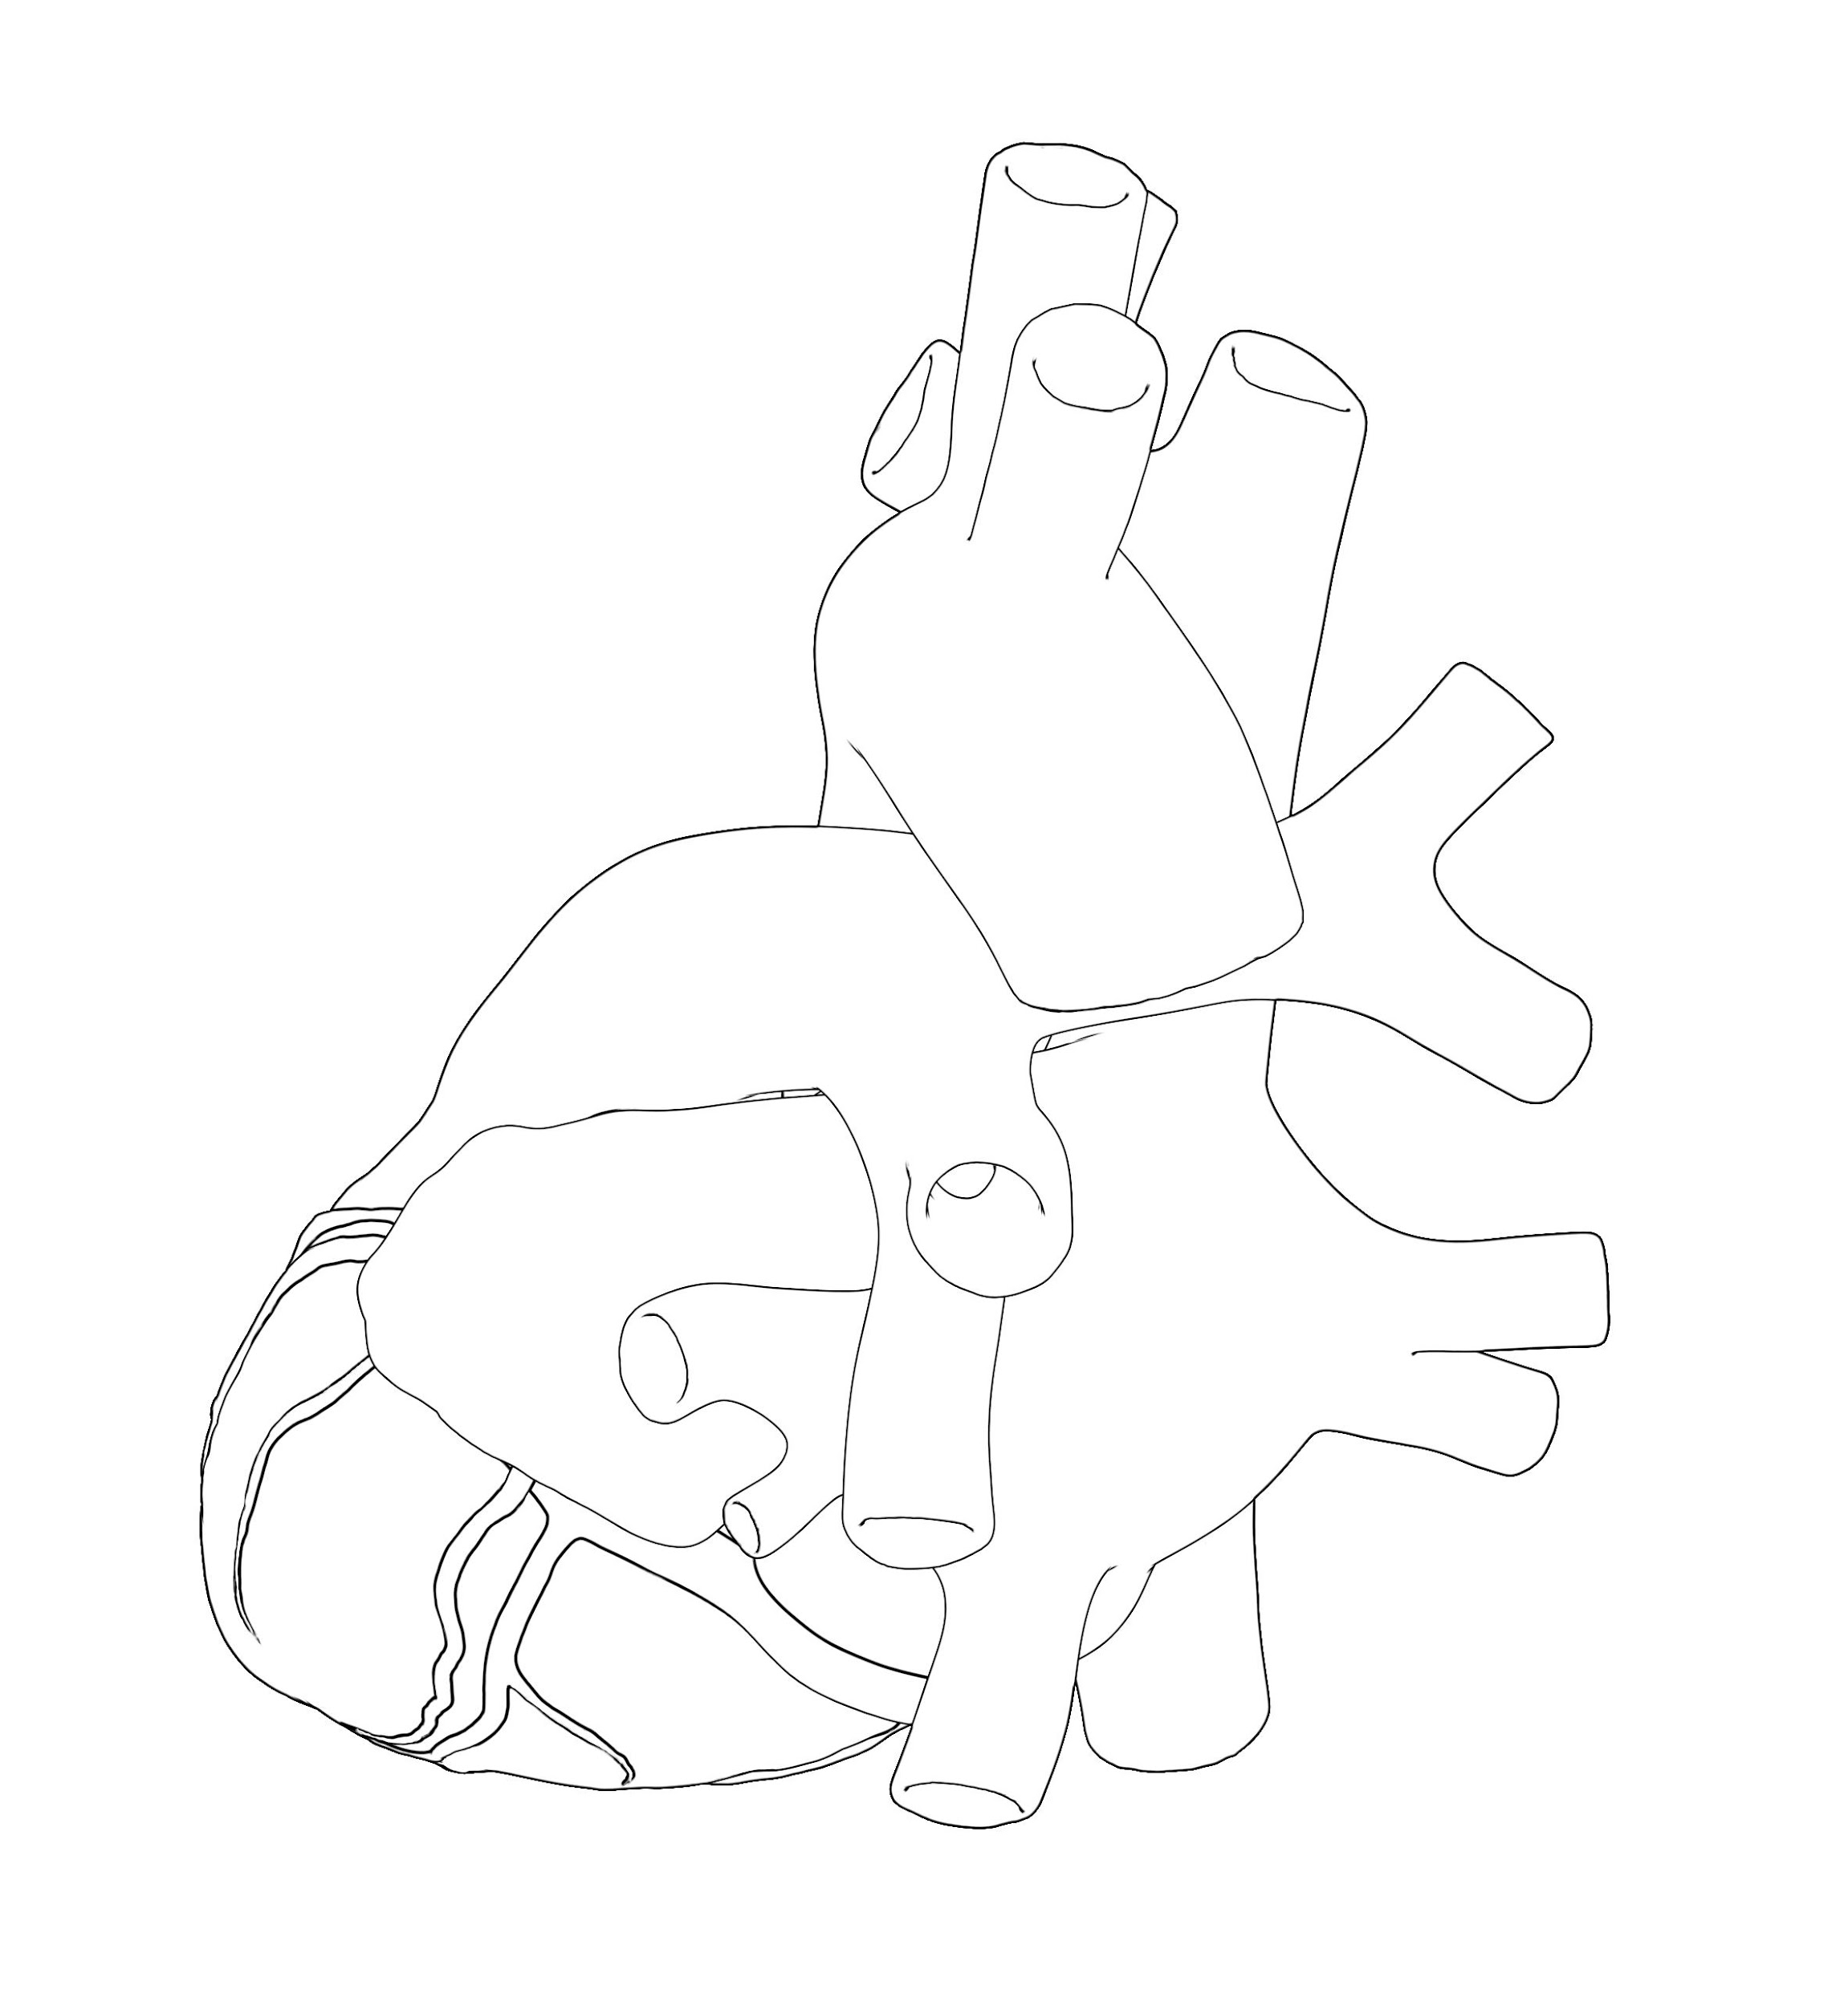

Slide 29
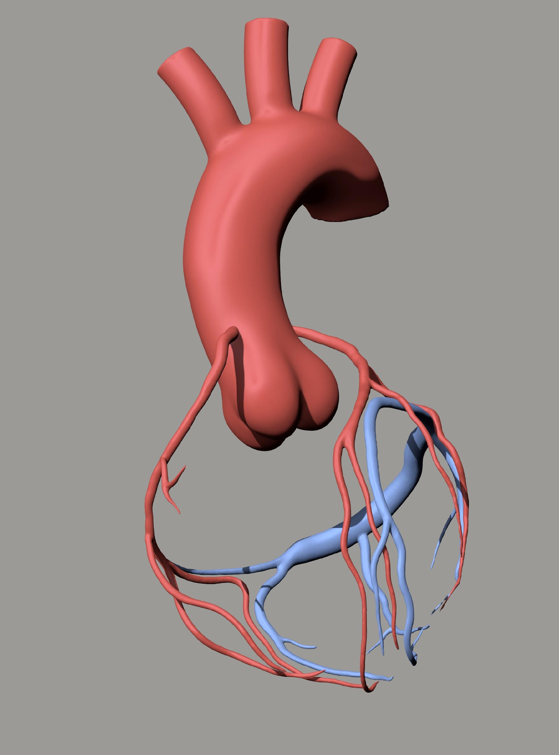

Slide 30
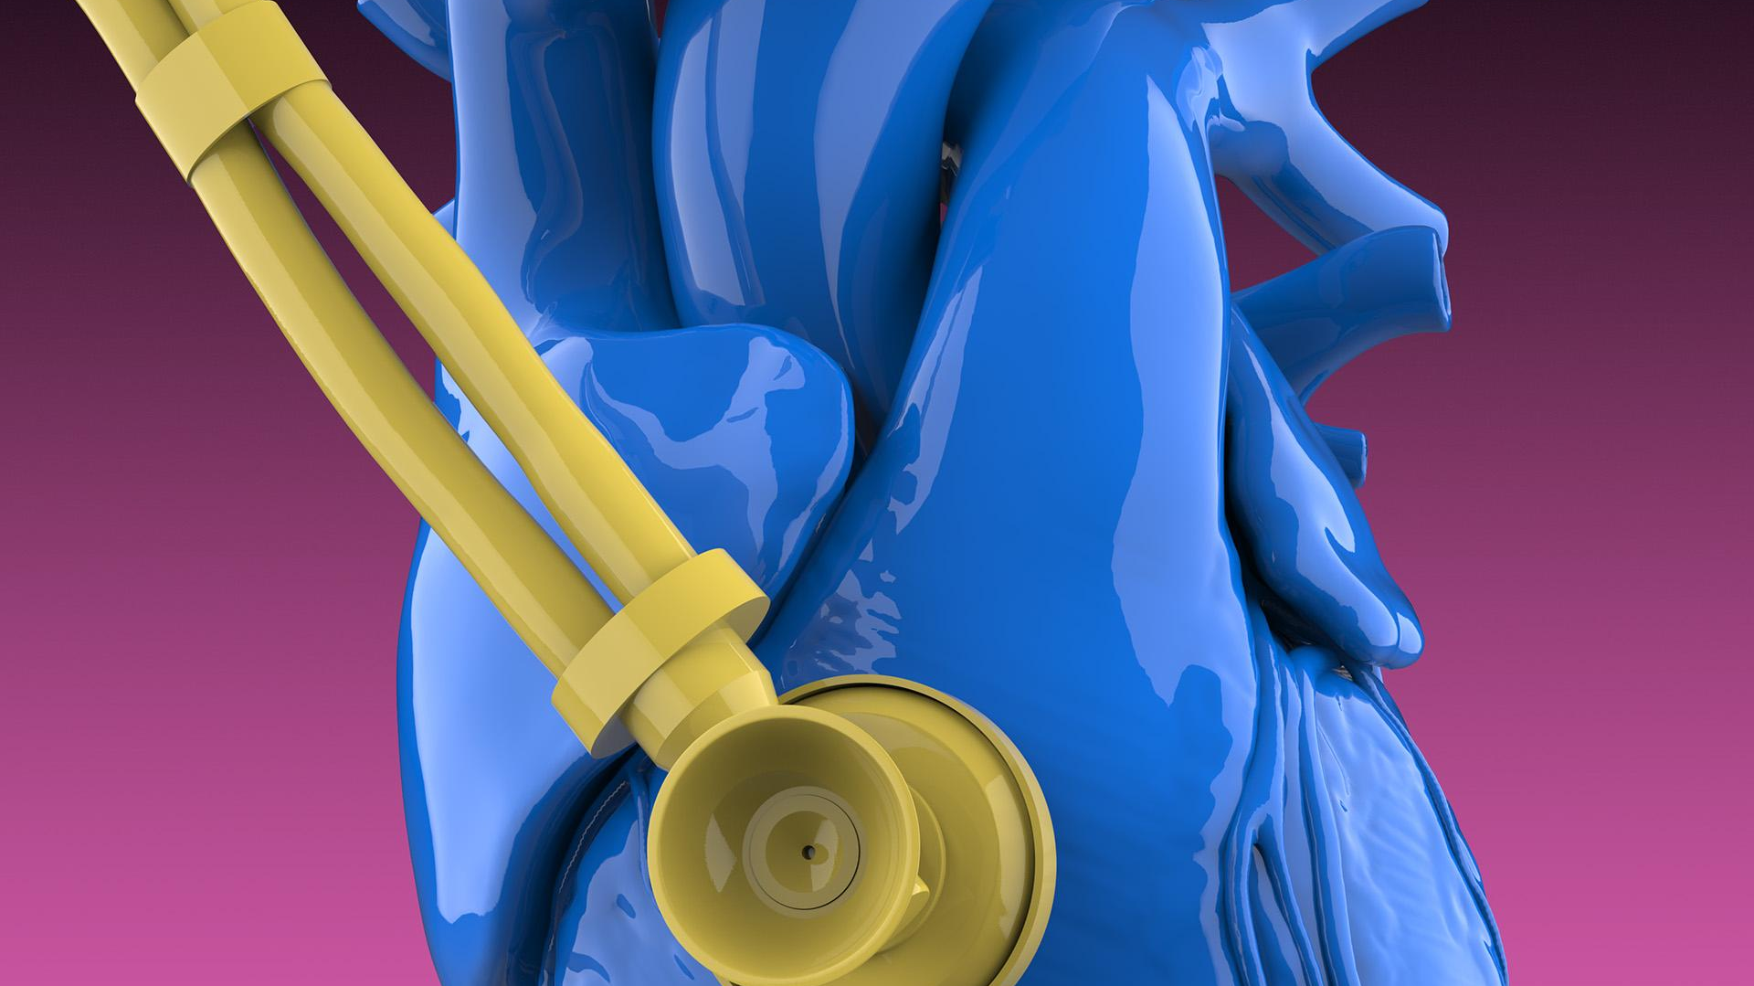

Slide 31

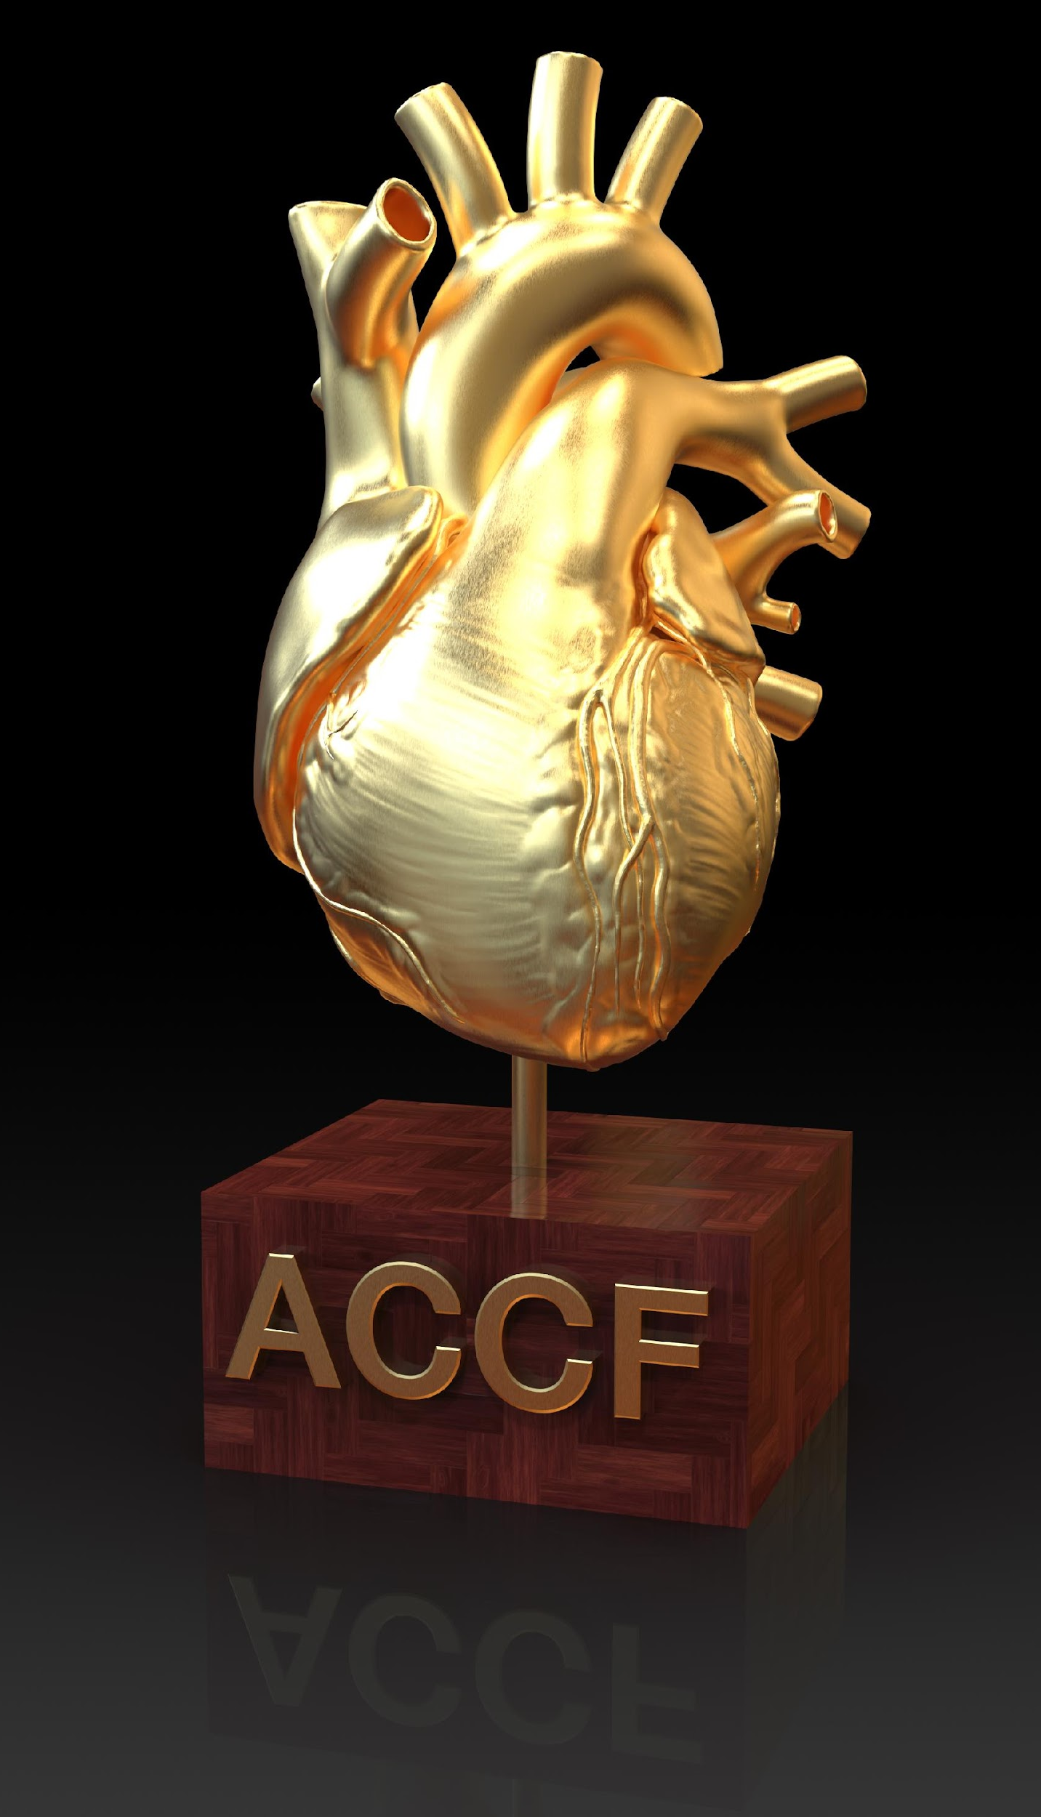
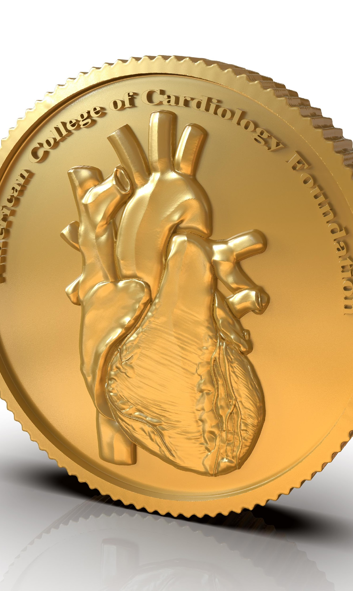

Slide 32
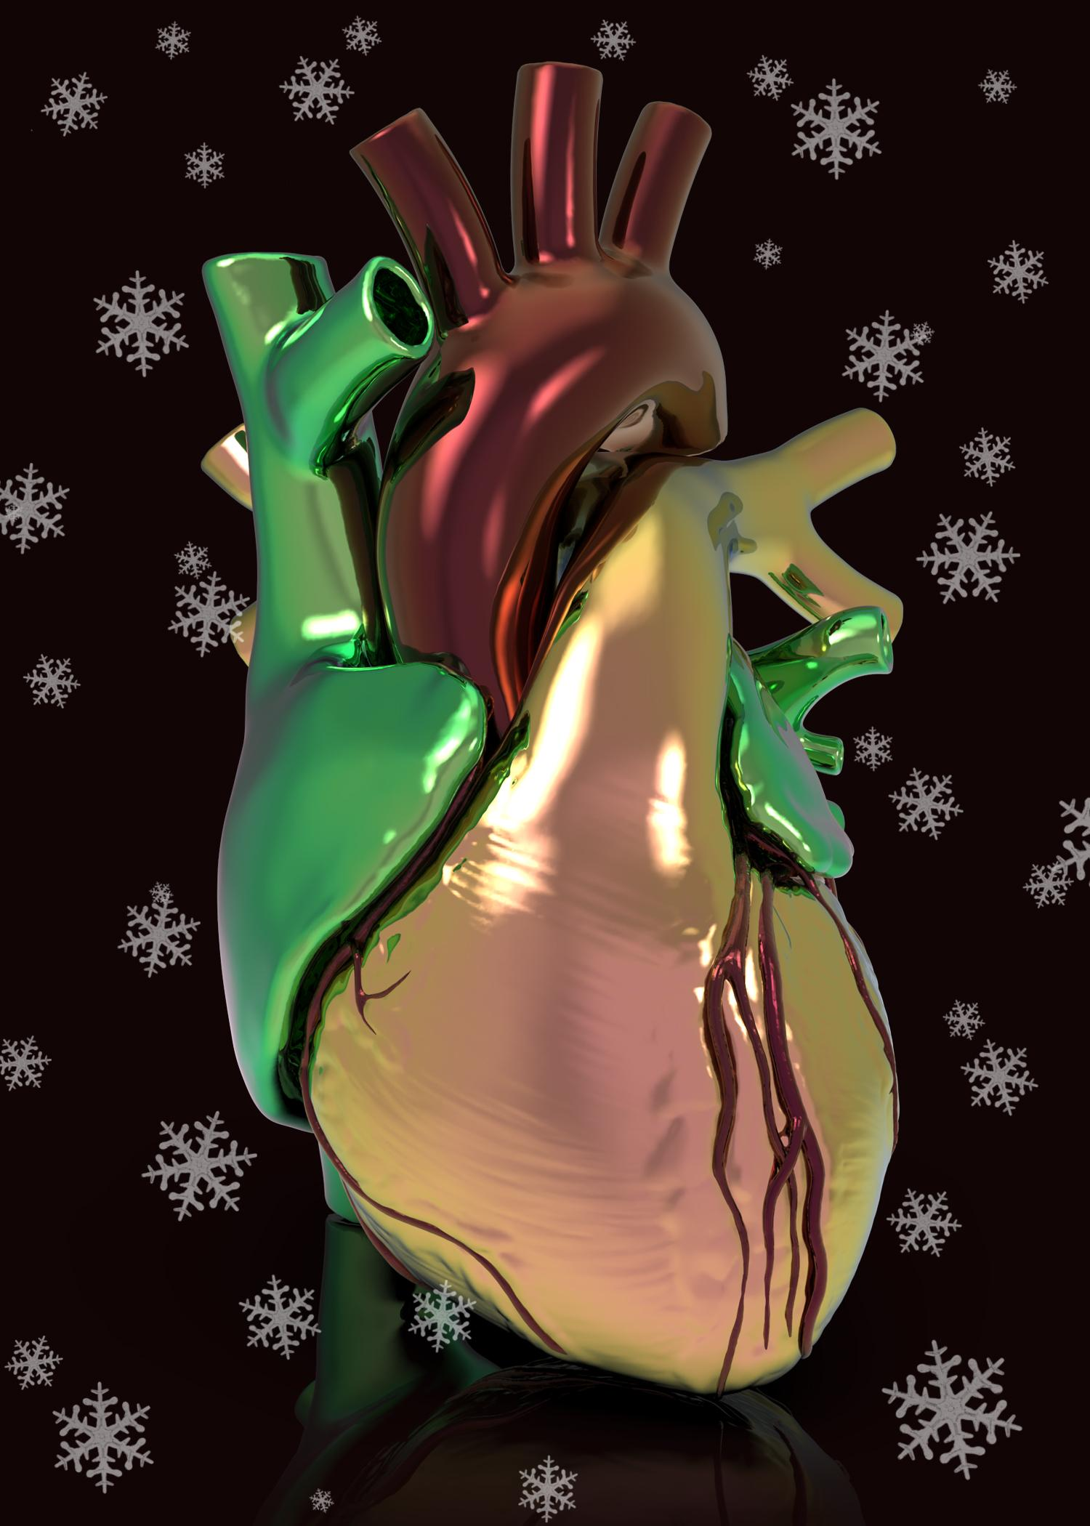

Slide 33
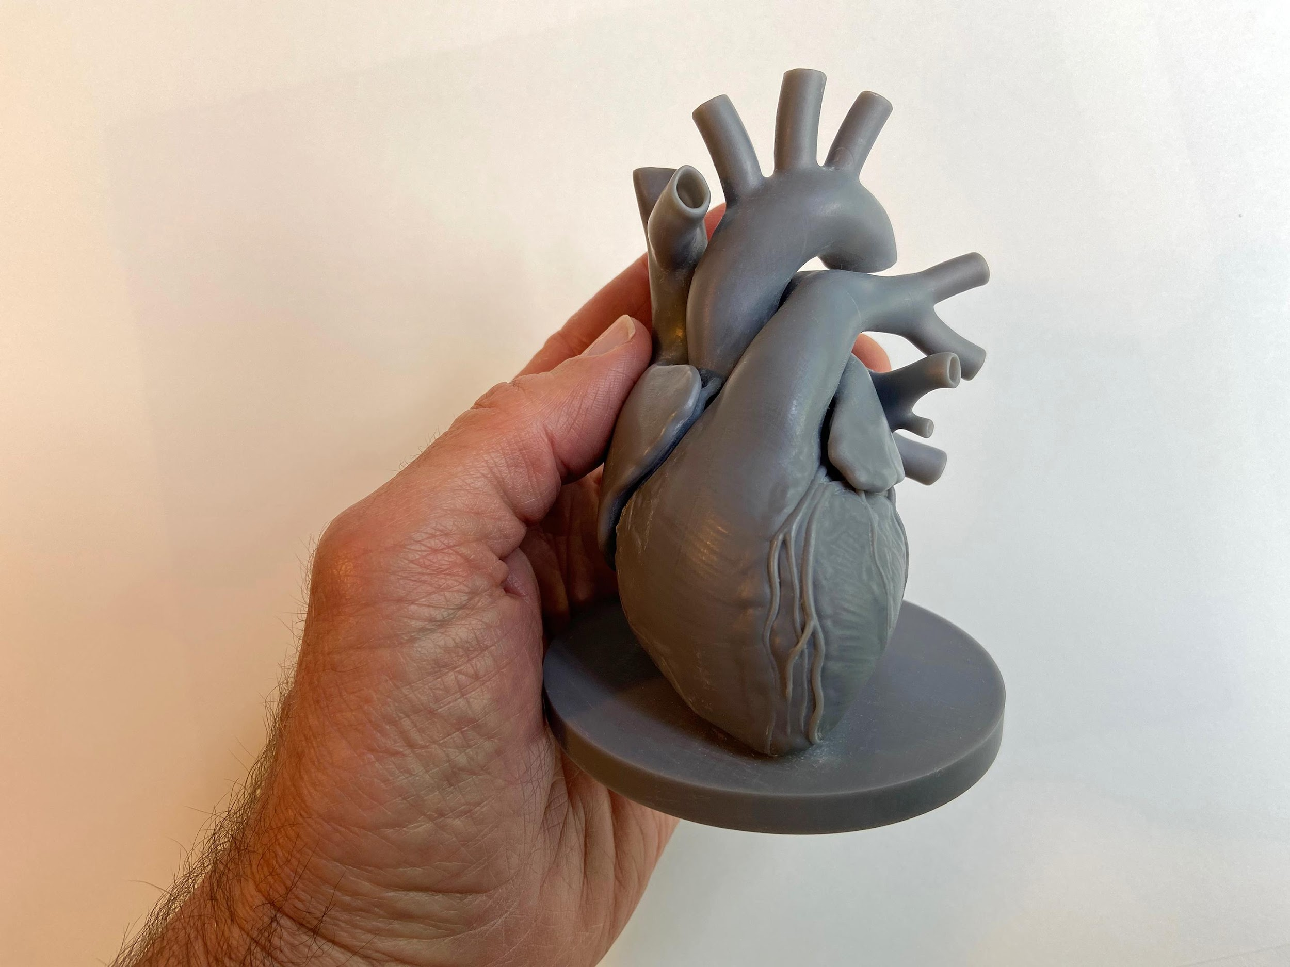

Slide 34
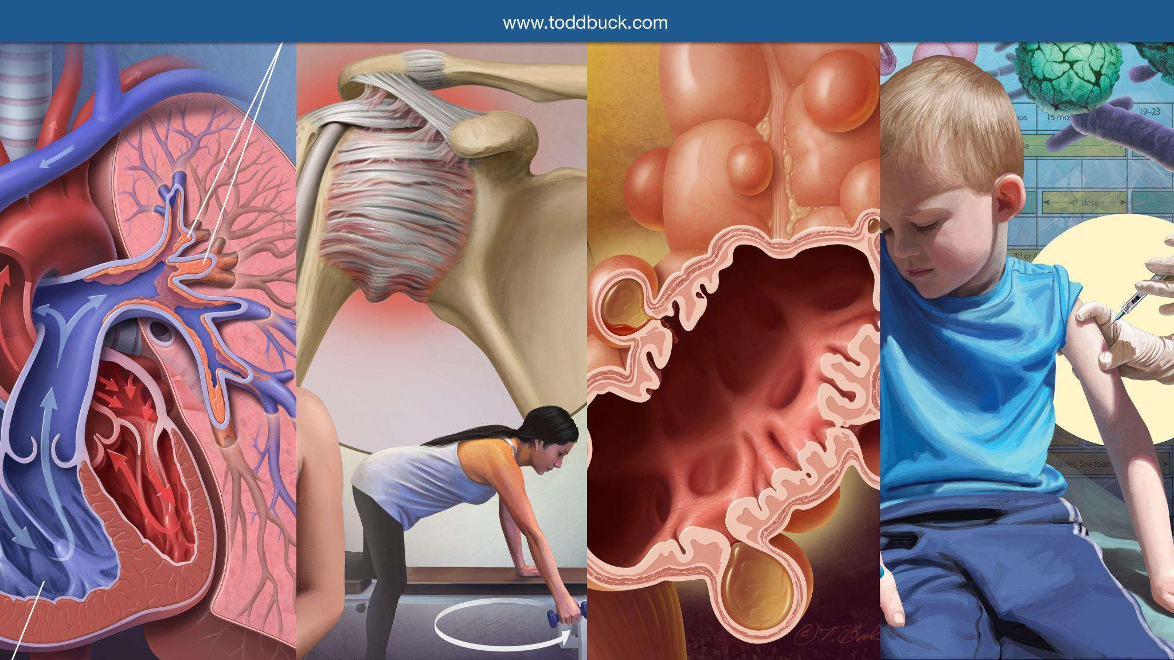

Slide 35
